Slide 1
Conditions
Cool-down of remaining sectors
Extensive Hardware Commissioning of circuits
Installation of remaining components
Individual system commissioning
Roll out of controls infrastructure
Roll out of beam interlock system
Roll out of beam instrumentation
Software development and deployment, roll out of magnet model etc…
Commissioning of access system (DSO tests etc.)
While starting-up and operating SPS/PS etc.

Slide 2
Approach
Define objectives and prioritize (as usual)
Individual System Tests/ Hardware Commissioning
Equipment groups/HWC team
Individual high level control tests
From CCC using controls infrastructure and software
Check the functionality of the individual systems
Integration tests (dry runs) + HWC/PGC
Debugging – establishing control & integration from the CCC
Partial machine checkout
Machine Protection commissioning
Full machine checkout
Try and document it – something we’ll have to do every year

Slide 3
Integration Tests (Dry Runs)
Multi-system tests to check integration and readiness of all systems involved in a given phase of LHC operations:
Check all equipment control functionality
Slow timing, fast timing, synchronization
Data acquisition
Alarms, logging, post mortem, fixed displays
Equipment control & access
Real-time feedback system
Analogue acquisition
Software
Controls infrastructure: servers, databases etc.
Software Interlock System
Management of Critical Settings
Role Based Access Control
Drive all relevant systems in a synchronized way through the standard operational sequence
Check machine protection and interlock systems
The devil is very much in the details.

Slide 4
Objectives – Deploy and Test LSA
Core Functionality
Optics, ramp, squeeze, magnet model (transfer functions etc.)
Equipment
Instrumentation
Measurements
Operational exploitation
Timing
On-line Models
MADX, FIDEL, Aperture
Mode, data distribution
Applied LSA applications
Orbit, luminosity scans etc.
Data exchange

Slide 5
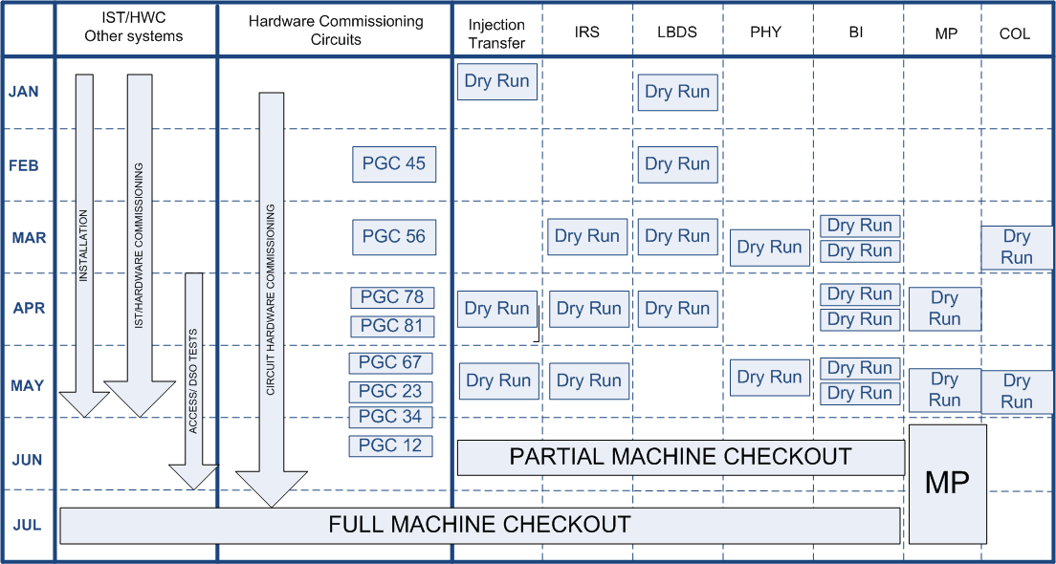
Approach

Slide 6
Organization
Coordinated by Operations. Preparations for, and results of, dry runs to be discussed at LHCCWG.
In close collaboration with equipment groups, technical issues to be discussed in ABCIS meetings.
Seen as a prelude to full system tests to be performed before beam
Injection & Transfer
LBDS
Injection, ramp & squeeze
Experiments
[Machine Protection]
[Beam instrumentation]

Slide 7
Comments
There’s a lot going on the same time
This not going to be particularly tidy or particularly easy
Accept dry runs as a debugging exercise
Accept it won’t be perfect first time
Iterate [but at an appropriate frequency]
Look for robust solutions that follow established standards.

Slide 8
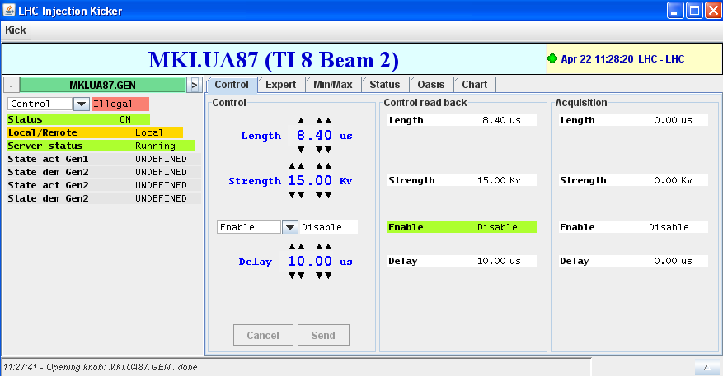
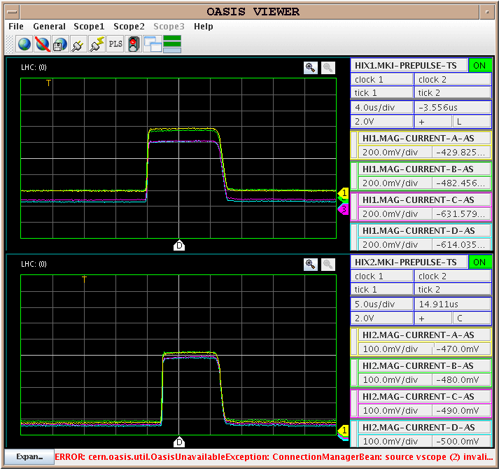
Injection/Transfer Dry Runs – Injection Kickers
Kickers
pulsing nominal voltage
control, monitoring, logging, settings, FD, OASIS
basic injection sequence ring1/ring2
Pre-pulses
Abort Gap Keeper
Advanced injection sequence

Slide 9
Injection/Transfer Dry Runs - timing
Timing & synchronization
Events
Event tables
Telegrams
Bespoke Injection requests
Interesting for us & the timing team
we learn something every time!
Sync in with SPS & Injectors
LHC mastership
Injection request
Beam Type
Inject & Dump, Circulate & Dump

Slide 10
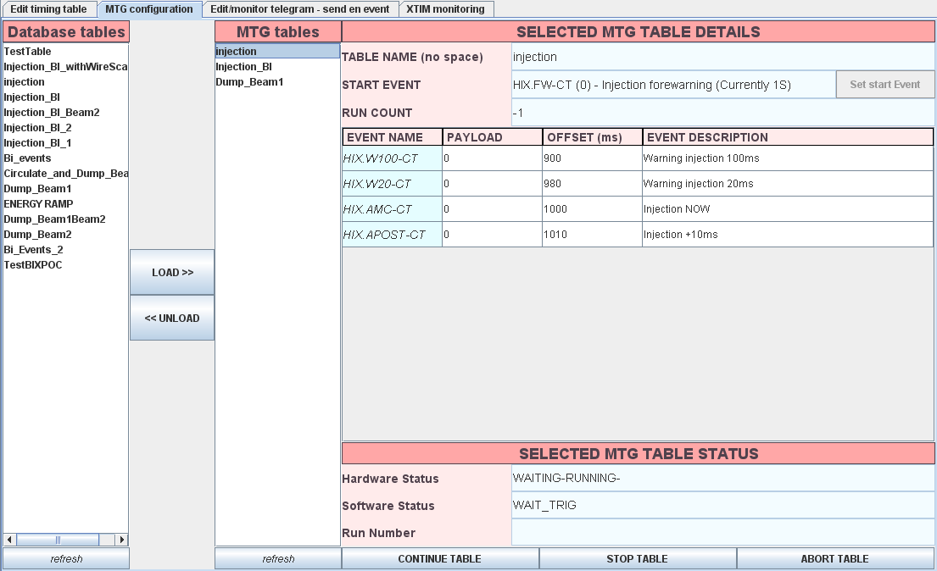
Timing

Slide 11
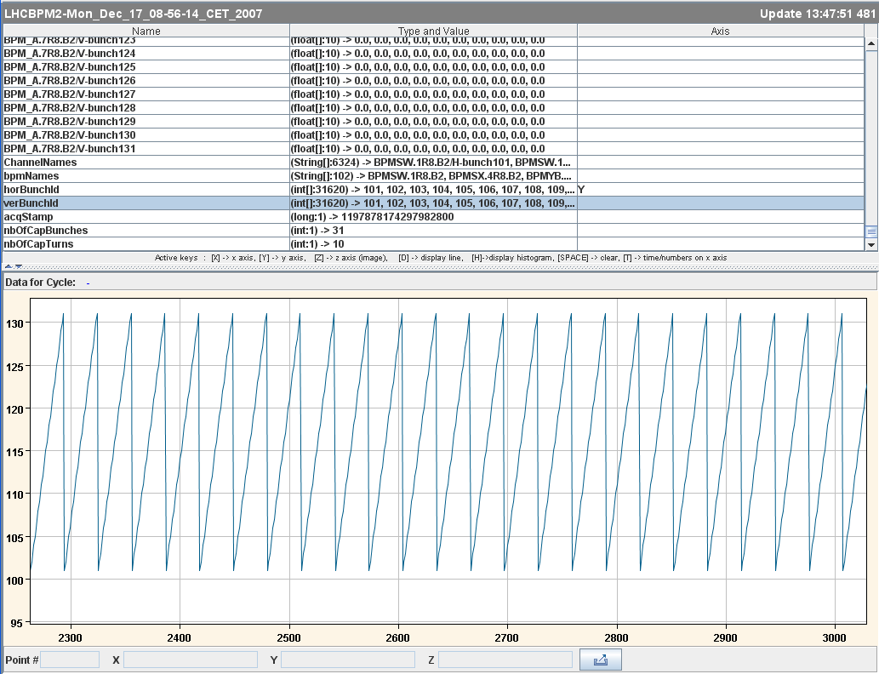
Injection/Transfer Dry Run - instrumentation
Instrumentation
Acquisition, concentration, post mortem, study buffers, logging, control, FD, timing etc.
BTV, BLMs , BPMs, BCTDC, BCTF, AGM etc……….

Slide 12
Injection/Transfer - Miscellaneous
Applications
YASP (threading, etc)
Sequencer
Injection Quality Checks
Multi-turn acquisition and analysis
Services
RBAC, MCS, Mode, DIP
BIS
Equipment control
Power converters
TDI
Transfer Line Collimators

Slide 13
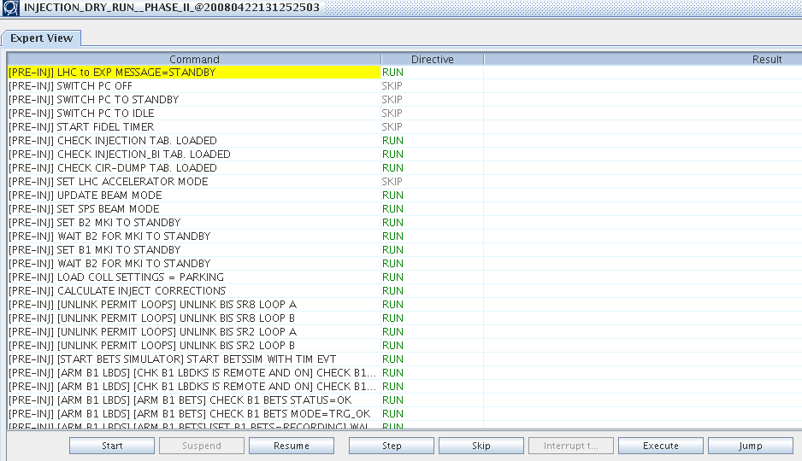
Inject & Transfer - sequencer

Slide 14
Injection, Ramp & Squeeze Dry Run
Power Converters/magnets:
Cold circuits – PGC or in simulation mode
All functionality & timing tested.
Collimators:
lab and/or tunnel
set, functions, limits etc.
Machine cycle
Injection versus intensity; Ramp, limits; Squeeze
Trim: Parameter space, limits
Interface to BIS
Monitoring, logging, FD, alarms etc
Optimization procedures
RF
RF units, cavities, loops etc., FGCs…

Slide 15
PGC as part of circuit HWC
Allows us to test & check:
LSA settings generation
Optics
Injection - Ramp - Squeeze - Ramp-down - Pre-cycles
Parameter space (Q, Q’, bumps, harmonics…)
Magnet Model (FIDEL)
Calibration curves
Harmonics, decay, snapback
Corrections
Sequencing machine cycle
Power converter functionality
Power converters
Tracking, control, ramping, squeezing (constraints), real-time

Slide 16
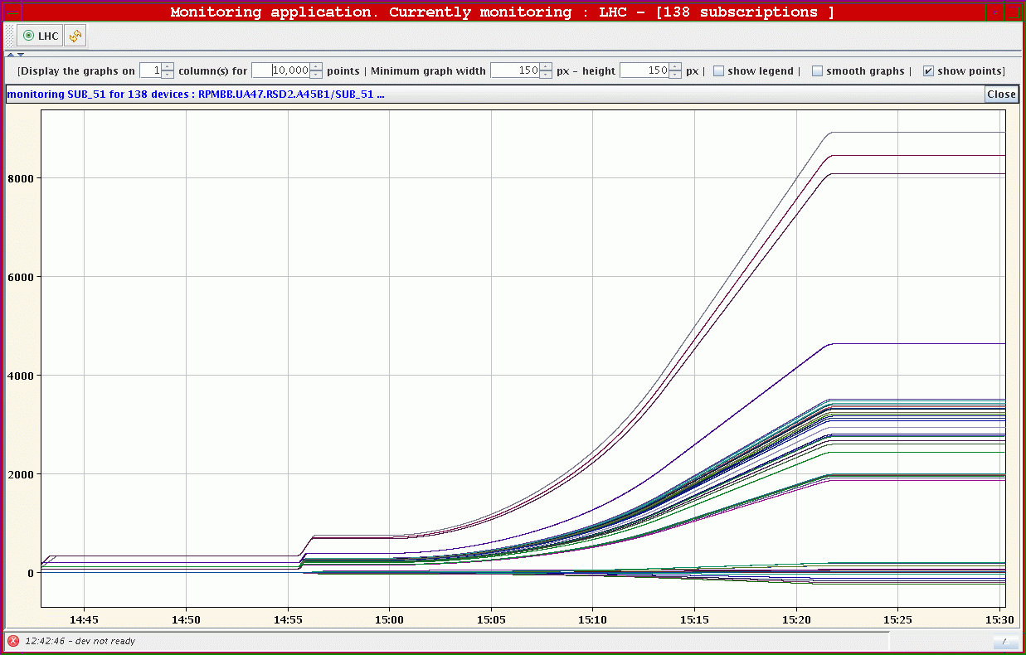
Ramp of 138 power converters in Sector 45 to a current equivalent to 5.3 TeV
19 February 2008,15:00

Slide 17
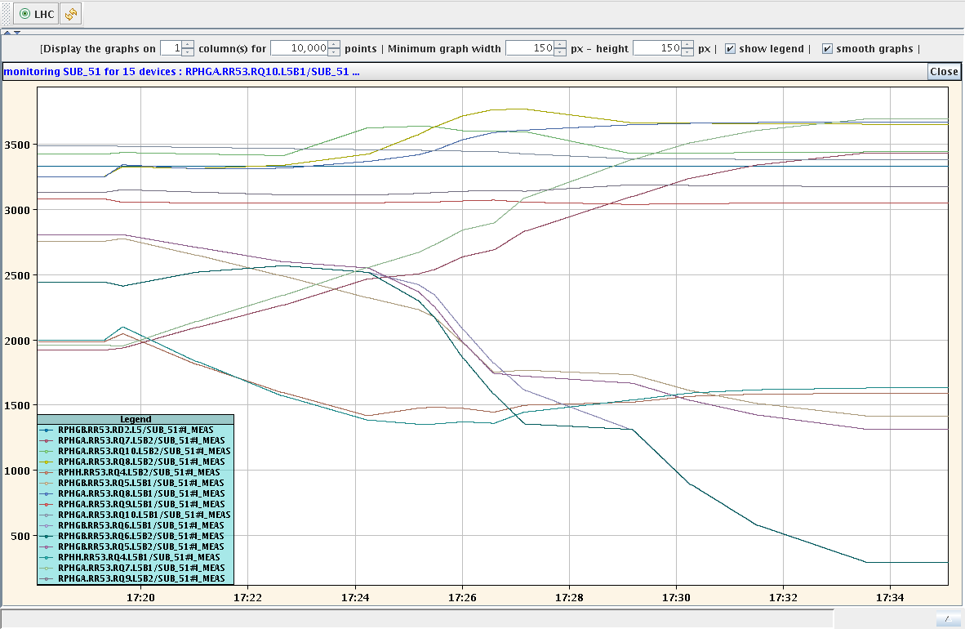
PGC – “HWC shadowing” – February 2008
Squeeze – L5

Slide 18
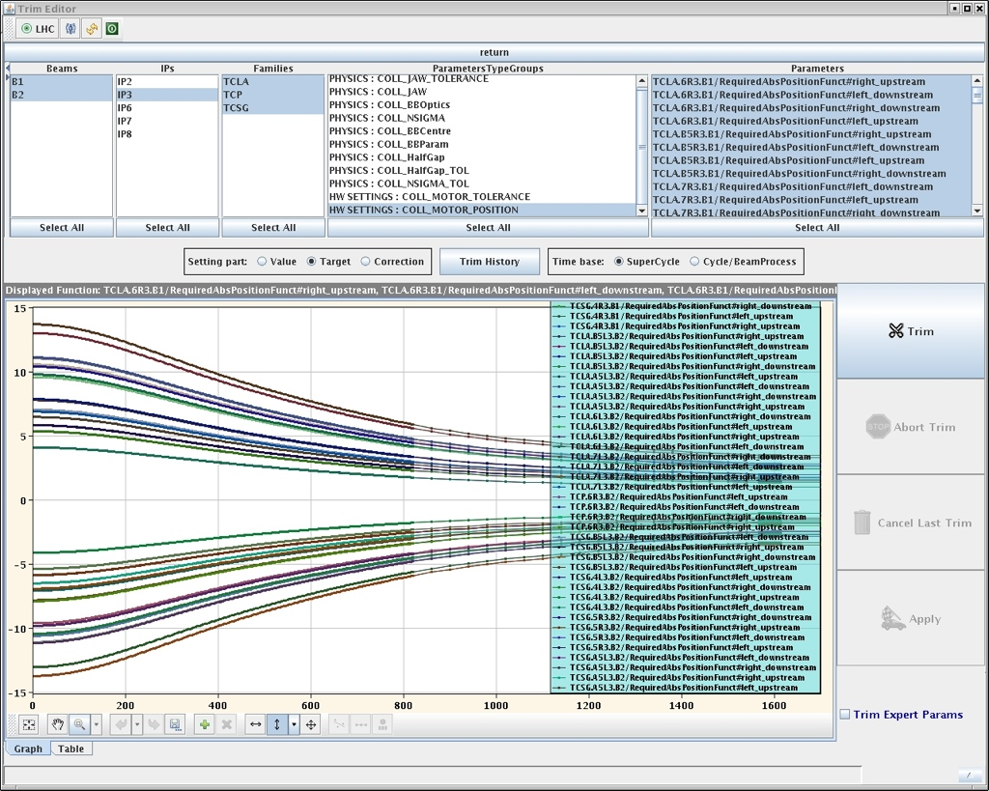
Collimators – settings generation
96 functions for all motors
Stefano Redaelli - acknowledgements Delphine, Eric, LSA

Slide 19
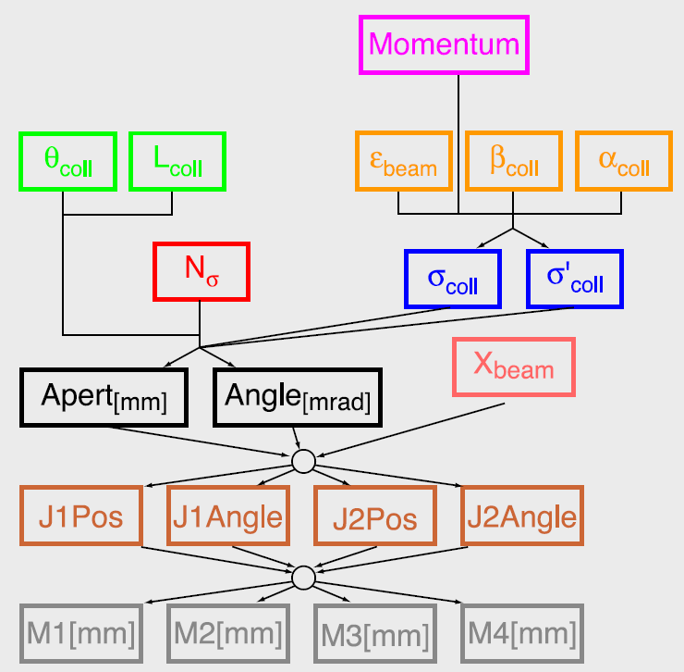
Collimators – parameter space
Stefano Redaelli

Slide 20
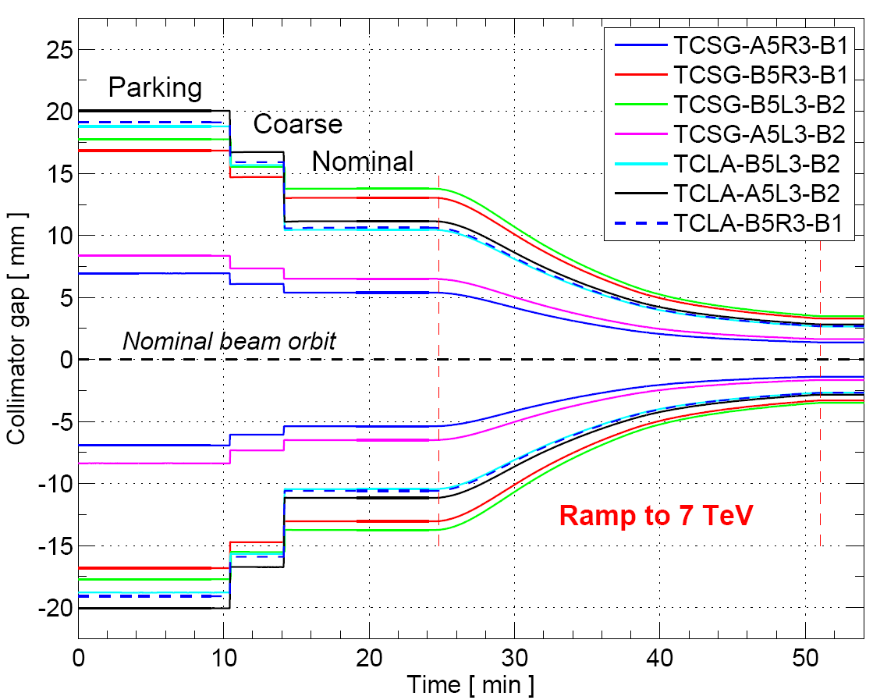
Collimators - drive
Stefano Redaelli

Slide 21
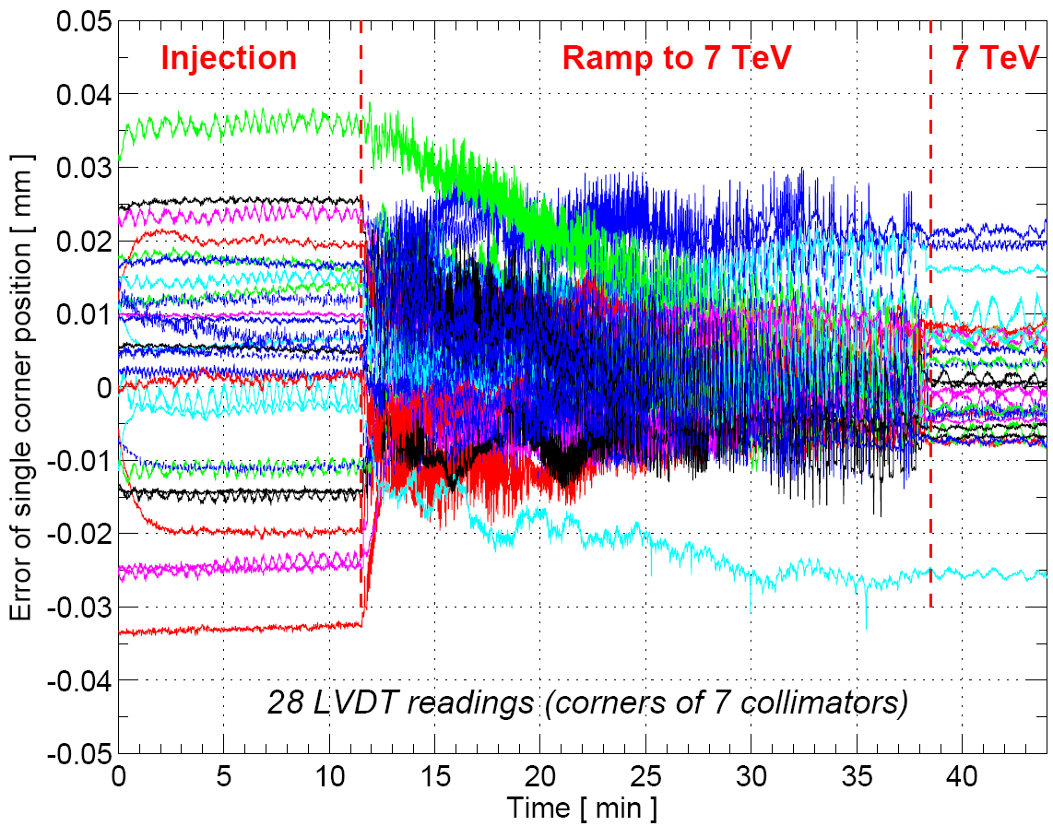
Collimators - measure
Stefano Redaelli

Slide 22
LBDS Dry Runs – Summary so far
Slides c/o Verena Kain
We are testing the following scenarios:
Programmed Dumps - post mortem suppressed
Circulate & Dump
Inject & dump
(Emergency dump caused by LBDS itself)
…USING ALMOST ALL INTERFACES
Either the real ones or simulated ones

Slide 23
LBDS Dry Runs
http://wikis/display/LHCOP/LBDS+Dry+Runs
Three dry runs so far: week 7, week 11, week 15
Week 7: beam 1 triggered by timing event directly, BI, XPOC v0
Week 11: beam 1 triggered by local permit loop (BIS loops beam 1), reliability run sequence
Week 15: beam 1 triggered by local permit loop, beam 1 LBDS input to beam 1 BIS (REAL arming), beam 2 triggered by timing event directly, SMP energy distributed, XPOC on server for beam 1 and beam 2, beam 2 BI, BSRA
Next dry run: week 19
Scope: beam 1 and beam 2 triggered by local permit loops, beam 1 LBDS and beam 2 LBDS input to local BIS, critical settings for look-up tables; inject & dump, abort gap keeper, injection inhibit

Slide 24
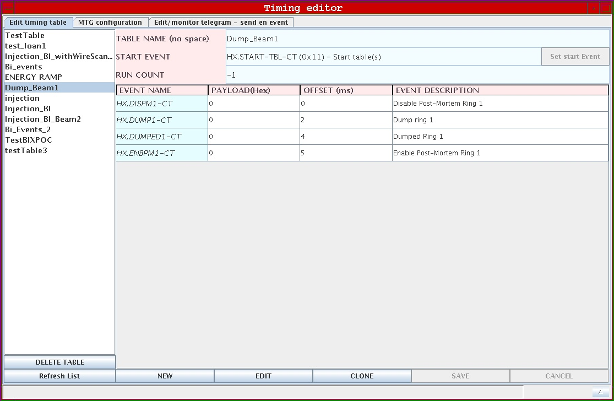
Programmed Dump
Normally
Breaks permit loop
Start table event, payload 17

Slide 25
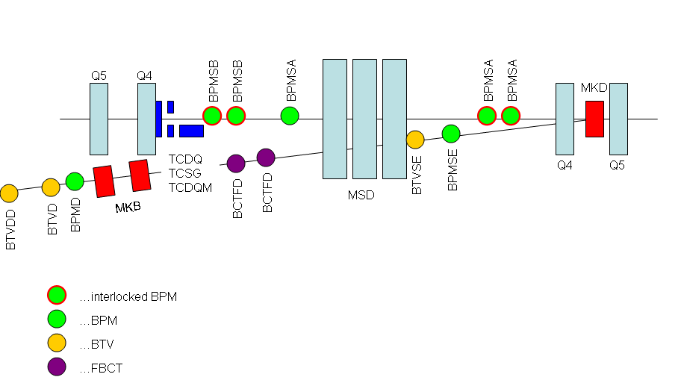
BI (1)
All BI working, except interlocked BPMs, for beam 1 and beam 2
…also Abort Gap Monitor
+ BLMs

Slide 26
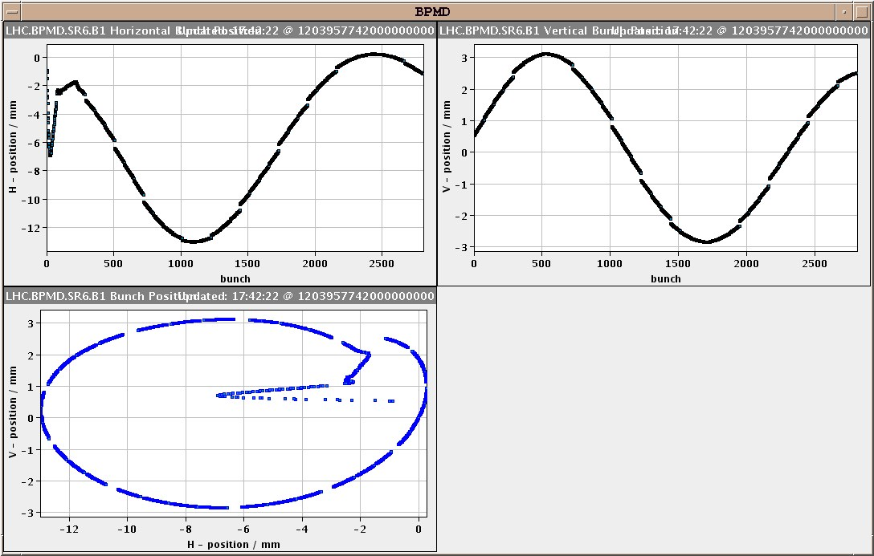
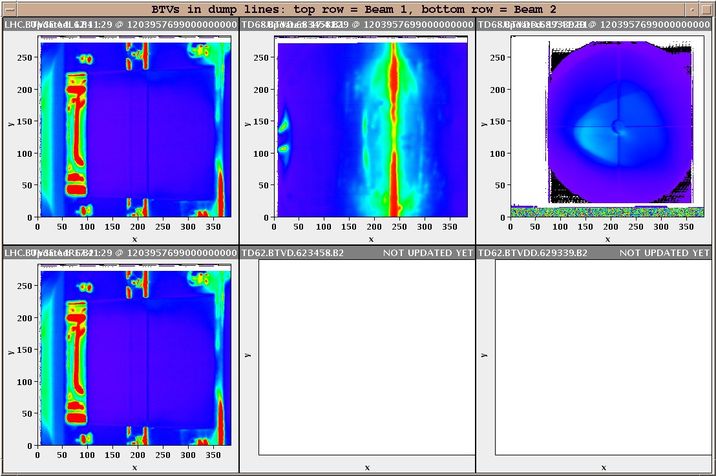
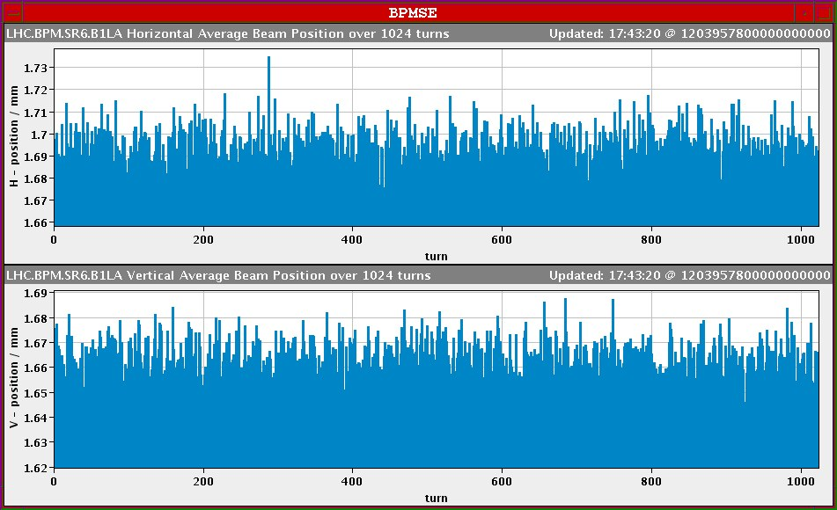
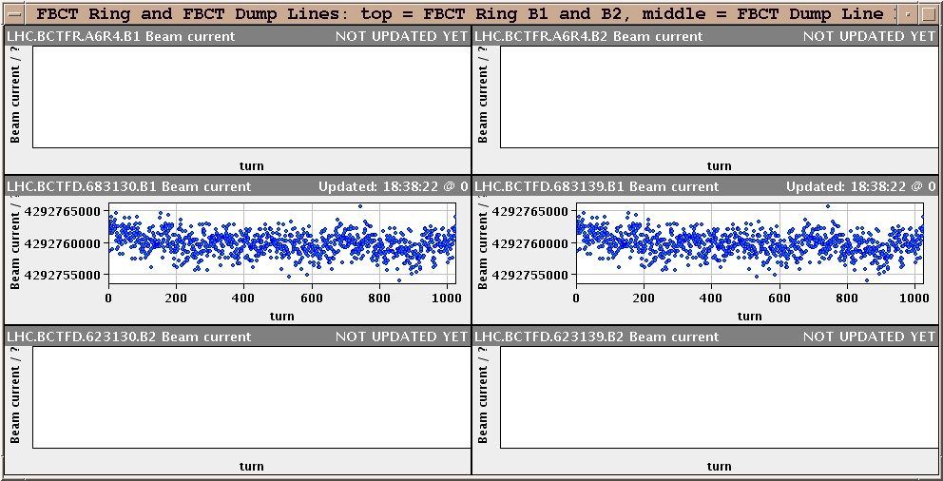
BI (2)

Slide 27
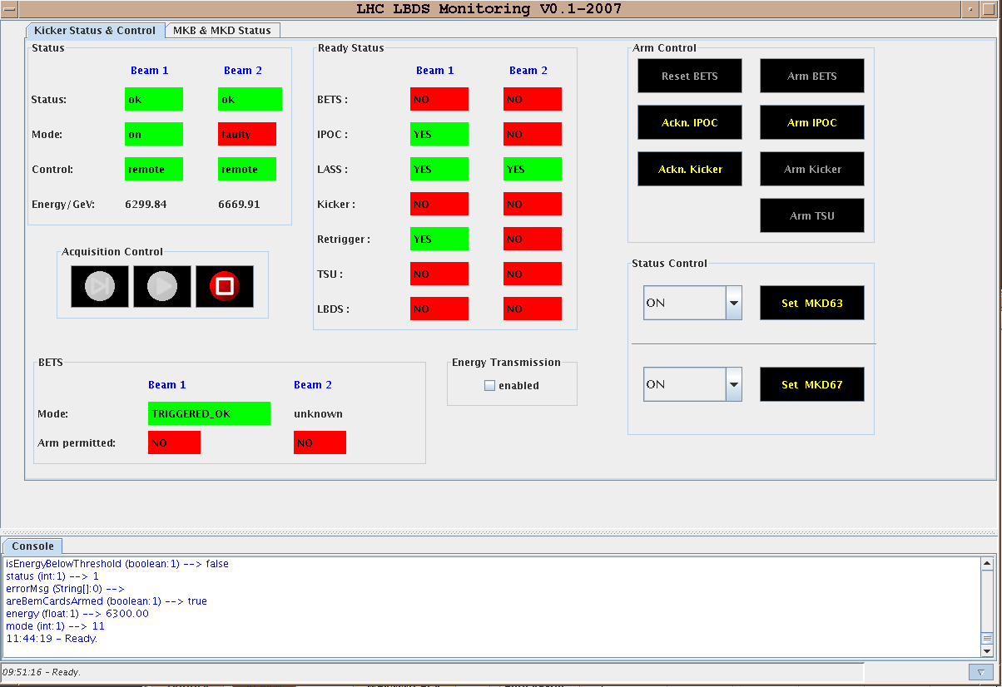
LBDS equipment and software (1)
LBDS system beam 1
LBDS system beam 2
BIS input for beam 1
LASS input is there
But masked
Dummy card for
direct BLMs
RF simulated frequency from point 4
Energy not from main bends, but BETSsim
LBDS Control and Monitoring GUI (M. Albert)

Slide 28
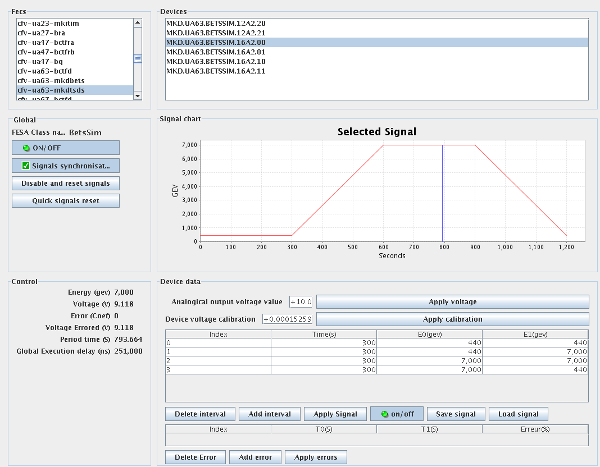
LBDS equipment and software (2)
Artificial energy reference – BETS simulator: for both beams
This energy is distributed
as SMP via the
timing...
1 Hz or 10 Hz for SMP energy distribution?

Slide 29
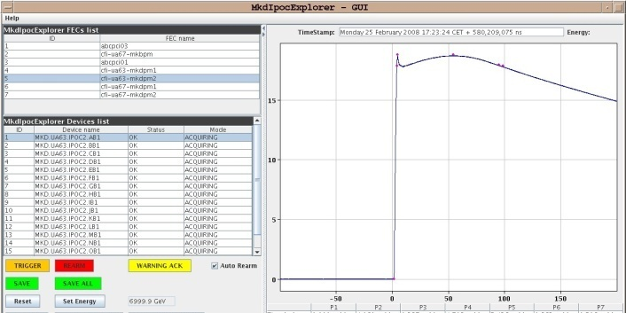
LBDS equipment and software (3)
BETS:
Beam energy tracking system working
IPOC:
Internal post operational check working
XPOC:
Post operational check
Analysis triggered by “beam dumped event”
Have version running for both beams on a server, publishing data to the logging and to the sequencer
Checks BI data and LBDS data after each beam dump

Slide 30
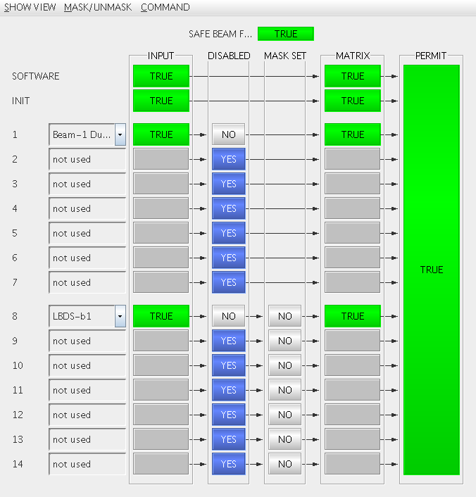
Local Permit Loops in point 6
Entry for the timing:
Dump beam x event
Entry for beam dump system
4 loops ( 2 per beam)
To test
Arming together with LBDS
Linking/unlinking

Slide 31
Controls
Logging:
Almost everything defined and being logged
Timing:
Dump beam x event: triggers beam dump
Beam x dumped events and post mortem events not automatically generated yet (generated in CCR – would need connection between point 6 and CCR via fibers)

Slide 32
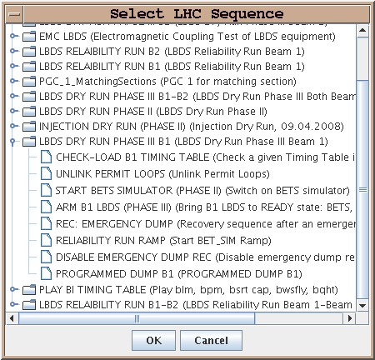
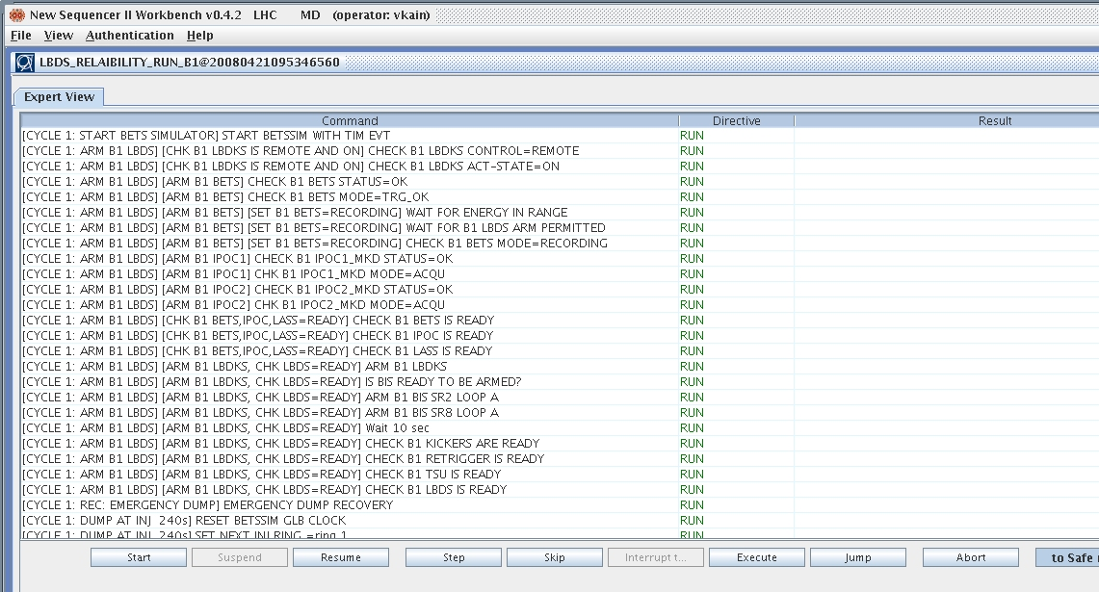
Sequencer
Heavily using the Sequencer for EVERYTHING
Reliability run, arming,…

Slide 33
Still open after the next (or last) dry run…
RBAC
Generation of global post mortem events and beam dumped events with full permit loop ready
During check-out
Energy reference from four main bend circuits
During check-out
Tracking of Q4 and MSD
During check-out
Real energy ramp all systems together:
TCDQ, Q4, MSD, main bends, LBDS
During check-out
Abort gap monitor software interlocking
Vacuum monitoring of dump line

Slide 34
Physics/Experiments Dry Run
Luminosity
Acquisition and display, BRA application
Optimization, trims, bumps etc.
Scans
Experiment Instrumentation & signals
BCMs, Lumi etc.
Experiment communication
DIP – to & from
Vetos, Handshakes
Interlocks
Beam abort, injection inhibit
Magnets
Alice/LHC dipoles and compensation

Slide 35
Machine Protection Dry Runs
As part of other dry runs & IST
Injection kickers
LBDS – link to BIS, protection devices
Integration in machine cycle
Resets, tests, SBF, SBP, BPF
Interface to timing system/BST
PM suppression
Link-Unlink
Injection inhibit
Experiments

Slide 36
Services

Slide 37
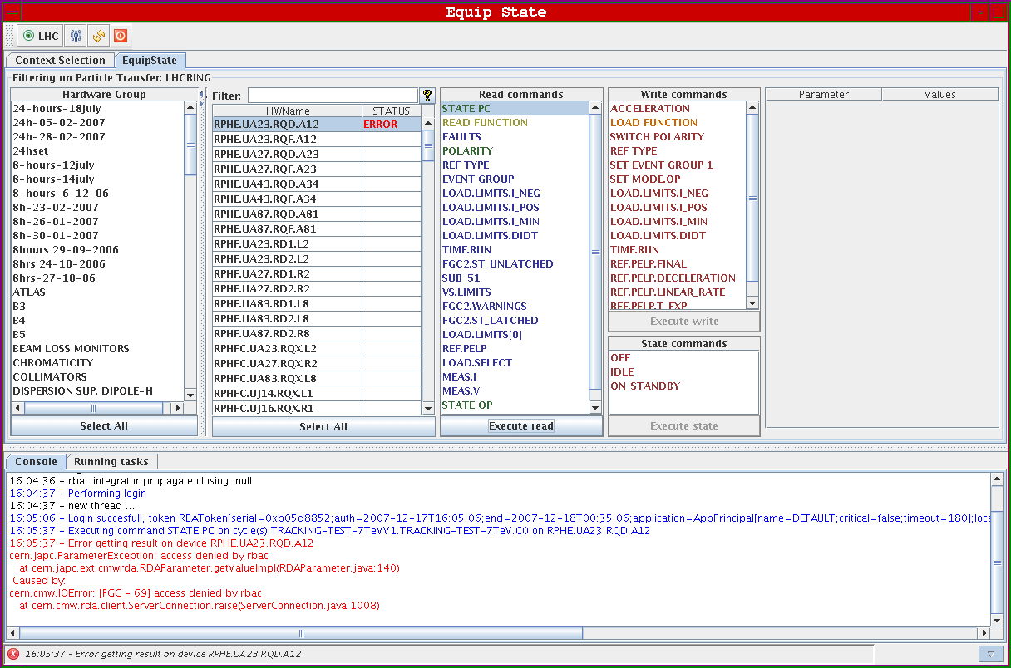
RBAC

Slide 38
Run Control
Accelerator Mode
Beam Mode
Fill Number
Bunch Configuration
Handshakes
Energy
As SMP to timing to DIP
LSA as source
Pushed to timing system
Pushed to DIP

Slide 39
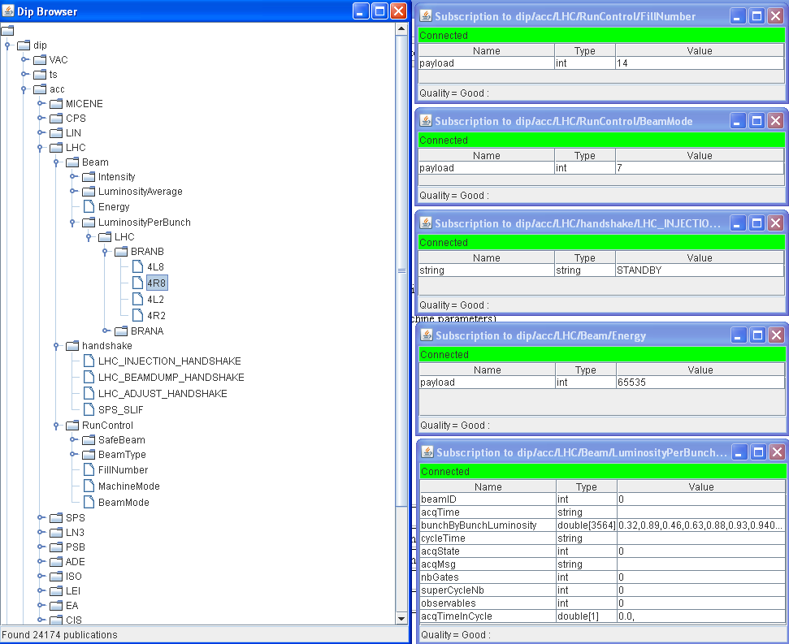
DIP

Slide 40
Mentioned in dispatches
Logging
Fixed Displays
Page 1
LSA
Core
Applications

Slide 41
Instrumentation

Slide 42
Instrumentation - DR 1/3
Find/organize time slots, also outside official dry runs where conditions allow testing of required functionality
Play simulated injection, ramp etc…
Plus dedicated dry runs
Beam Loss Monitors - acquisition & concentration | roll out
Beam Loss Monitors - XPOC, Post mortem, study buffers | test, test, test
Beam Loss Monitors - Logging | roll out and test
Beam Loss Monitors – OP display | ops
Beam Loss Monitors – expert application | To spec
Beam Loss Monitors – MCS – configuration & tests –threshold management | MCS, application and test
Bunch Current Transformers acq & display BCTDCLHC & BCTFDLHC & BCTFRLHC | Acq, log, FD

Slide 43
Instrumentation – DR 2/3
BPM: acquisition & concentration & publish All modes: capture, FIFO, orbit | Logging, SDDS, roll out and test
BPM: acquisition, log, display | Roll out
BPM: trajectory and orbit correction | YASP
BPM: multi-turn analysis | Application - test
BPM: beta beating analysis | Application – deploy and test
BPM: real time feed back | Deploy and test
BPMDLHC - dump line BPM | XPOC
BPMITLHC – interlocked BPMs | Acq/BIS, XPOC
BTVI/BTVMLHC Screens (matching monitors) | Acq, Control, BIS

Slide 44
Instrumentation – DR 3/3
Tune/kickers (tune, aperture, AC dipole) | control- acq – timing- applications – deploy and test
Radmon (TW) | acq – conc - display
BQHTLHC – head-tail Chromaticity
BSRALHC Abort gap monitor | Deploy & test
BSRTFLHC/BSRTSLHC Synchrotron radiation monitors | Deploy & test
BGILHC – Rest Gas Monitor | Deploy & test
BWSLHC Wire Scanner | Deploy & test
Wall Current Monitors (RF) | Talk to Andy
BQSLLHC - Schottky | Deploy & test
BRASCLHC/BRASGLHC - Luminosity monitors | Application++ +LSA

Slide 45
Objectives- Instrumentation
 | Priority | Conc | Settings | State | Logging | PM | SIS | MCS | Application | FDisplay | Daemon
BPM [D,I] | 1 | X |  |  | X | X |  |  | XX | X
BLM | 1 | X |  |  | X | X |  | X | XX | X
BCT [DC, FD, FR] | 1 |  |  |  | X |  |  |  |  | X
BTV | 1 |  | X | X | X |  | X |  | X | X
Rest Gas [BGI] | 3 |  | X | X | X |  | X |  | X
Sync. Rad [BSRA] | 1 |  | X | X | X |  | X |  | X |  | X
Wire Scanners [BWS] | 2 |  | X |  | X |  | X |  | X |  | X
Luminosity [BRA,S,G] | 1 |  |  |  | X |  |  |  | X | X | X
Tune [BQBBQ] | 1 |  | X | X | X | X |  |  | XX
Tune [BQHT] | 2 |  |  |  |  |  |  |  | X
AGM [BSRA] | 2 |  |  |  | X |  |  |  | X | X
Schottky [BQS] | 2 |  |  |  | X |  |  |  | X |  | X
BST [BOB] | 1

Slide 46
Objectives - Hardware
 | Application | XPOC | Analog Acquisition | Alarms | SIS | MCS | PM | Timing | RBAC
INJECTION KICKERS | X |  | X | X |  | X | X | X | X
BEAM DUMP | X | X | X | X |  | X | X | X | X
POWER CONVERTERS | XX |  |  | X | X |  | X | X | X
COLLIMATORS | X |  |  | X | X | X | X | X | X
RF | XX |  | X | X | X |  | X | X | X
TRANVERSE FB | X |  | X | X |  |  | X | X | X
MAGNETS | XX |  |  | X |  |  | X
MKQA etc | X |  |  | X | X |  | X | X | X
WARM MAGNETS | X |  |  | X | X |  | X | X | X
RADIATION MONITORS |  |  |  | X |  |  | X
SPECTROMETERS |  |  |  | X | X |  | X | X

Slide 47
So far…
LHCb – November 2007
Injection dry run – December 2007
Beam dump dry run – February 2008
Alice – February 2008
PGC 4-5 – February 2008
Injection & Transfer/Beam dump – April 2008
Injection & Transfer/Beam Dump/PGC – May 2008

Slide 48
Incoming – week 19
Timing tests
including injectors, injection requests etc.
Injection & Transfer
pre-pulse
Injection sequence
LBDS
Injection, ramp & squeeze
Power converters/Magnets
PGC 56, 23 in simulation
Full machine cycle including pre-cycle, decay compensation etc.
Experiments
will push communication gently
Details at: http://wikis/display/LHCOP/Home
Concluding remarks…

Slide 49
Acknowledgements
Ioan Kozsar; Julian Lewis; Benjamin Todd; Bruno Puccio; Lars Jensen; Ana Guerrero Ollacarizqueta; Stephane Bart Pedersen; Michael Ludwig; Bernd Dehning; Christos Zamantzas; Jean-Jacques Gras; Jan Uythoven; Etienne Carlier; Nicolas Magnin; Nicolas Voumard; Christophe Chanavat; Marine Gourber-Pace; Ronny Billen; Chris Roderick; Reyes Alemany Fernandez; Vito Baggiolini; Fabio Follin; Markus Albert; Guy Crockford; Marek Misiowiec; Grzegorz Kruk; Jerome Axensalva; Laurette Ponce; Eric Gallet; Brennan Goddard; Mike Lamont; Verena Kain
Andy Butterworth
Brennan Goddard
Bruno Puccio
Delphine Jacquet
Etienne Carlier
Georges Henry
Ioan Kozsar
JJ Gras
Jorg Wenninger
Julian Lewis
Lars Jensen
Markus Albert
Reyes Alemany
Stefano Redaelli
Stephane Deghaye
Stephen Page
Verena Kain
plus a lot of support from equipment groups and controls

