Slide 1
LHC Machine Check-Out and Beam Instrumentation LHCCWG– J-J GRAS [AB-BI] / Gianluigi Arduini [AB-ABP]

Slide 2
Nominal Workflow = Outline of my Talk
Monitor Installation
HWC Procedure Documentation
Manufacturing & Test Folder Instantiation – NC Handling
Getting Access during others HWC periods
Update MTF
HWC of our monitors
Machine Check-Out
Ready for Beam

Slide 3
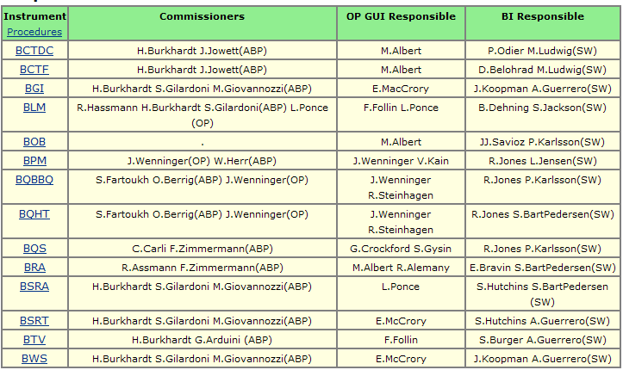
Machine Check Out
Once HWC is ok, we can start machine check out of an instrument in order to
Check its integration in the control system
Check its functionality
Debug it as much as we can before beam
Have people involved (‘commissioners’ from OP/ABP) knowing and 'owning' the systems.

Slide 4
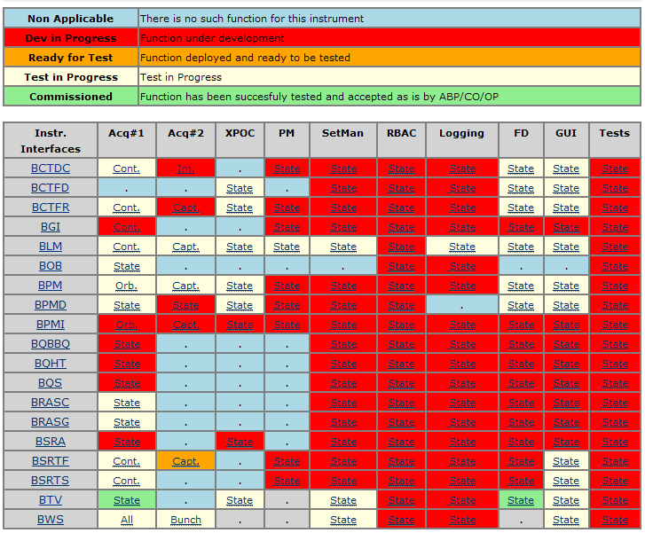
Machine Check Out
RBAC implementation will start when the configuration tools will be ready
2 dedicated test servers are in place to assess our logging needs before migration to operational servers
Test of the software public interface agreed with OP/ABP
We will base this activity on the summary dashboard on our Wiki Web.
Testing processes introduced in the LHC sequencer to regularly (ie before each fill) check the status of our instruments
Fixed Displays and Graphical User Interfaces

Slide 5
Machine Check Out
The BI SW responsible of the instrument knows best what can be tested and when.
He/She will organize the continuous assessment of its instruments, ie:
find/organize time slots, also outside official dry runs, where conditions allowing to test a (or several) box of the dashboard are met.
Invite the instrument team members to test the box together or by sub-groups depending of the case
maintain the dashboard info up to date (color scheme and details on the box dedicated page) and prepare battle field for the next iteration

Slide 6
Machine Check Out
In addition to this, we will also participate to the LSA dry runs. This dashboard should help the organiser to know what they can use
To work efficiently between these official dry run, we’ll need a sequence of events (injection, BLM/BPM/BSRT/BQ measurements, start of ramp, beam dumped,...) that LSA should play for us regularly outside dedicated dry runs.

Slide 7
Requested Timing Table 1/2
Injection beam #1
Tinj1-1000msec HX.FW-CT (561)
Tinj1-10msec HX.BLMCAP-CT (578)
Tinj1-1msec HX.BPMCAP1-CT (584)
Tinj1-1msec HX.BCTFCAP1-CT (576)
Tinj1-1msec HX.BSTRCAP1-CT (586)
Tinj1 Injection beam#1 (next slide)
Tinj1+100msec HX.BWSFLY-CT (588)
Tinj1+100msec HX.BQHT-CT (591)
Sleep 20secs
Injection beam #2
Tinj1-1000msec HX.FW-CT (561)
Tinj1-10msec HX.BLMCAP-CT (578) ??
Tinj2-1msec HX.BPMCAP2-CT (585)
Tinj2-1msec HX.BLMCAP-CT (578)
Tinj2-1msec HX.BCTFCAP2-CT (577)
Tinj2-1msec HX.BSTRCAP2-CT (587)
Tinj2 Injection beam#2 (next slide)
Tinj1+100msec HX.BWSFLY-CT (588)
Tinj1+100msec HX.BQHT-CT (591)
Sleep 1 mn (feedback, orbit, logging…)
Energy Ramp per steps (like Etienne) every 20sec with each step
HX.BLMCAP-CT (578)
HX.BPMCAP1-CT (584)
HX.BCTFCAP1-CT (576)
HX.BSTRCAP1-CT (586)
HX.BPMCAP2-CT (585)
HX.BCTFCAP2-CT (577)
HX.BSTRCAP2-CT (587)
HX.BWSFLY-CT (588)
HX.BQHT-CT (591)
Sleep 2 mn (feedback, orbit, logging…)
Beam #1 dumped HX.DUMPED1-CT (574)
Sleep [variable 0ms->1mn]
Beam #2 dumped HX.DUMPED2-CT (575)
Sleep 30 sec
Set energy to 450GeV
Send ‘Start Simul Table’ event (TBD) to Check Instrumentation.
Sleep 2mn and go back to 1

Slide 8
Requested Timing Table 2/2
For injection, Ioan can create LTIMs multiplexed on the next injected beam telegram group (RNGI). However this is not yet handled by LSA as RNGI is always 1 (=NO-RING). Could we have this?
Etienne is currently playing following energy steps (much slower, ie 10mn per steps) [450, 500, 600, 700, 800, 900, 1000, 1250, 1500, 1750, 2000, 2250, 2500, 3000, 4000, 5000, 6000, 7000 GeV]. We could, if easier, scan energy from 0 to 65535 in GMT per step of 64 every 250 ms.
We want to test our ‘as good as new’ routines. Can we agree on a temporary CTIM for that (also transmitted to the workstations via Ethernet) during the machine check-out period.

Slide 9
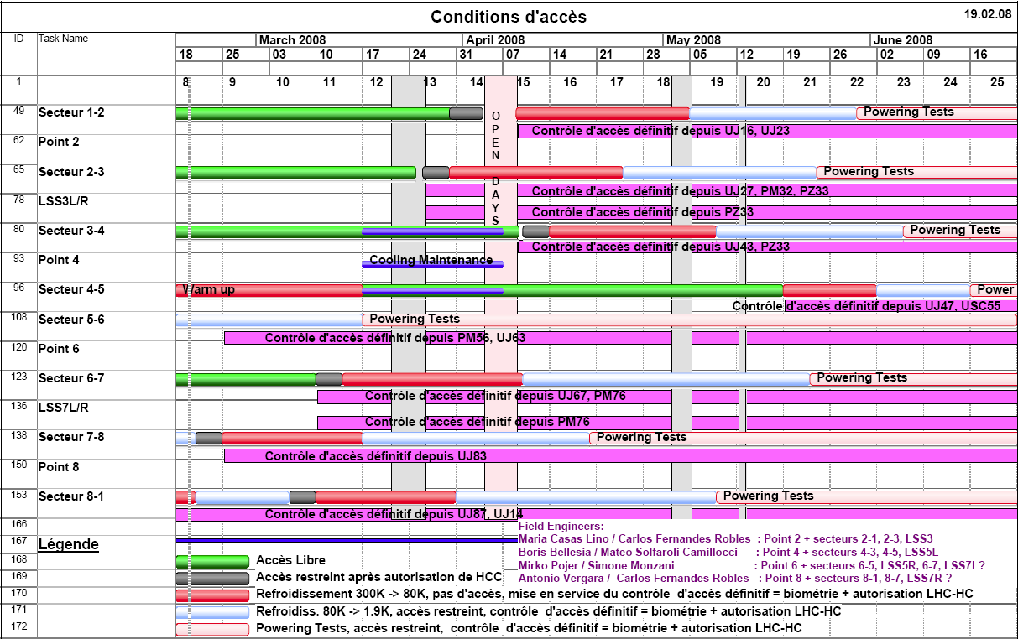
What’s next if we agree 1/2
Free Access
No Access
RF Tests – No Access for Months!
Restricted Access
Most BI individual instruments and a part of BLM and BPM should be ready for first tests around here

Slide 10
What’s next if we agree 2/2
LSA team has to create (and maybe extend to other equipment groups) , test and run on regular bases (TBD) the proposed timing table.
BI will organize a dedicated meeting per instrument before the end of March to present people and system state and plan and launch the activity

