Slide 1
Non-conformities and their consequences
M. Giovannozzi
Non-conformities for sector 5-6
Non-conformities for sector 4-5
Follow up of powering strategies during hardware commissioning
Acknowledgements: R. Bailey, M. Lamont, S. Russenschuck, A. Siemko, W. Venturini Delsolaro.

Slide 2
Introduction
Information available from the LHC HC web page
http://hcc.web.cern.ch/hcc/nonconform.html
The non-conformities can be split in two classes:
  ELQA: polarity, instrumentation, etc.
  Powering: magnet performance
Most of the non-conformities are closed. However, the system (MTF) allows closing a non-conformity with disposition “Decision pending”!
NB: a LTC presentation by S. Russenschuck is scheduled to report about ELQA status.

Slide 3
Non-conformities for sector 5-6 - I
Short statistics:
  16 NCs found
  13 NCs closed (but 8 With disposition “Decision pending”)
  3 NCs still opened
  14 ELQA-related NCs
  1 POW-related NCs
  1 remaining NC (test of the MBs)

Slide 4
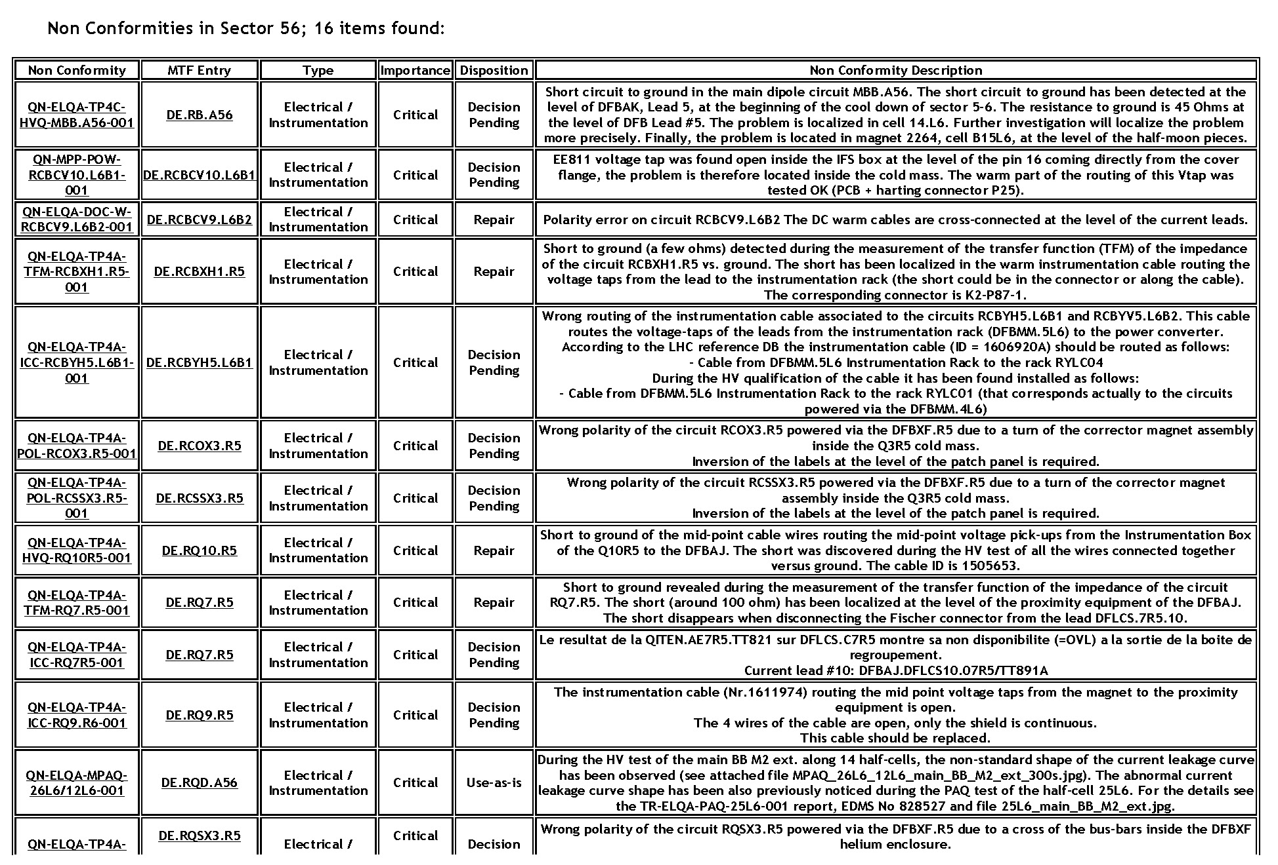
Non-conformities for sector 5-6 - II

Slide 5
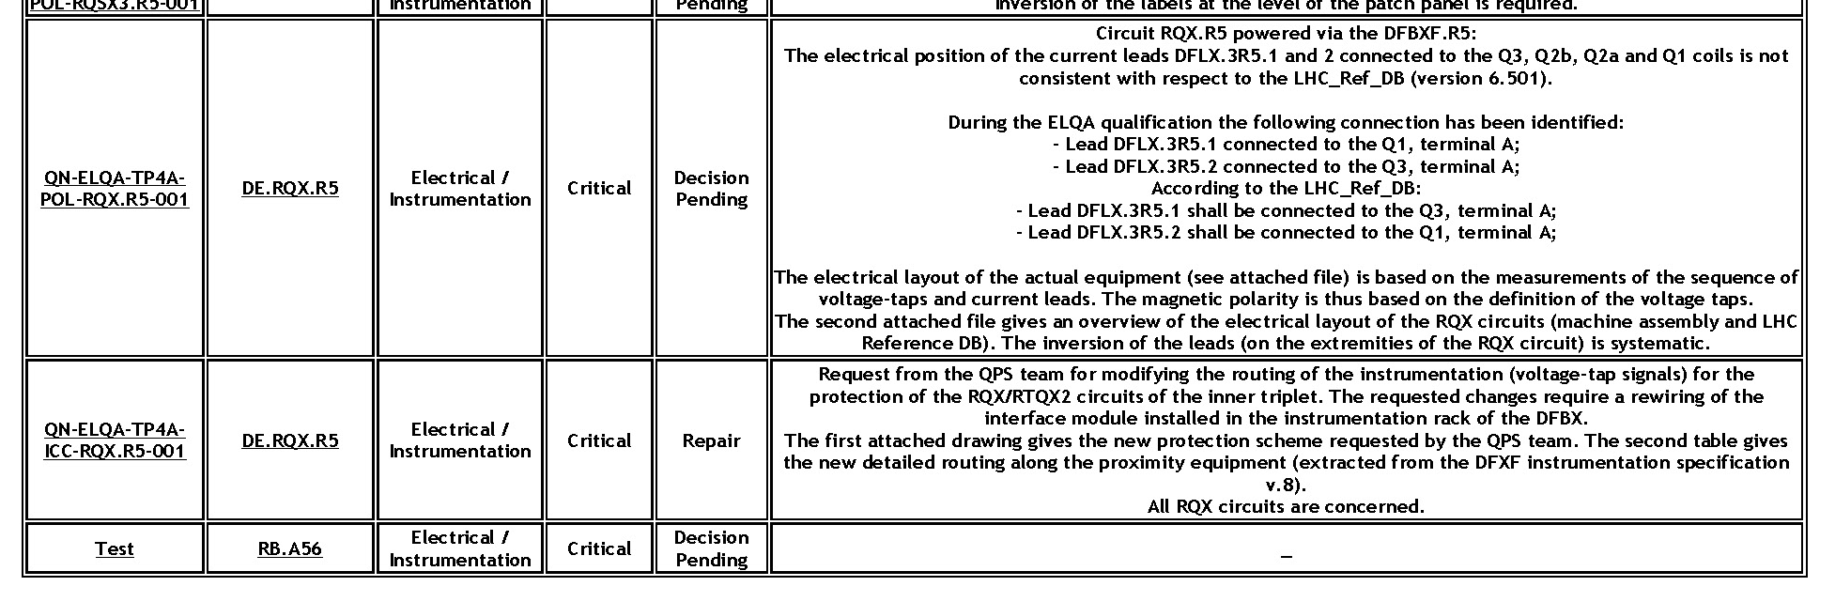
Non-conformities for sector 5-6 - III

Slide 6
Non-conformities for sector 5-6 - III
Two main issues:
  MCBCV10.L6.B1 (comments by A. Siemko): problem with its protection. One voltage tap is lost. Some extra tests should be performed to assess whether:
    Repairing action possible
    Limit current
  Triplet quadrupoles (and correctors) polarity error (comments by S. Russenschuck): known and systematic error (e.g., MQSX). Only solution is to change the polarity at the level of the patch panel. Presentation at the MPP given (14/04/08).

Slide 7
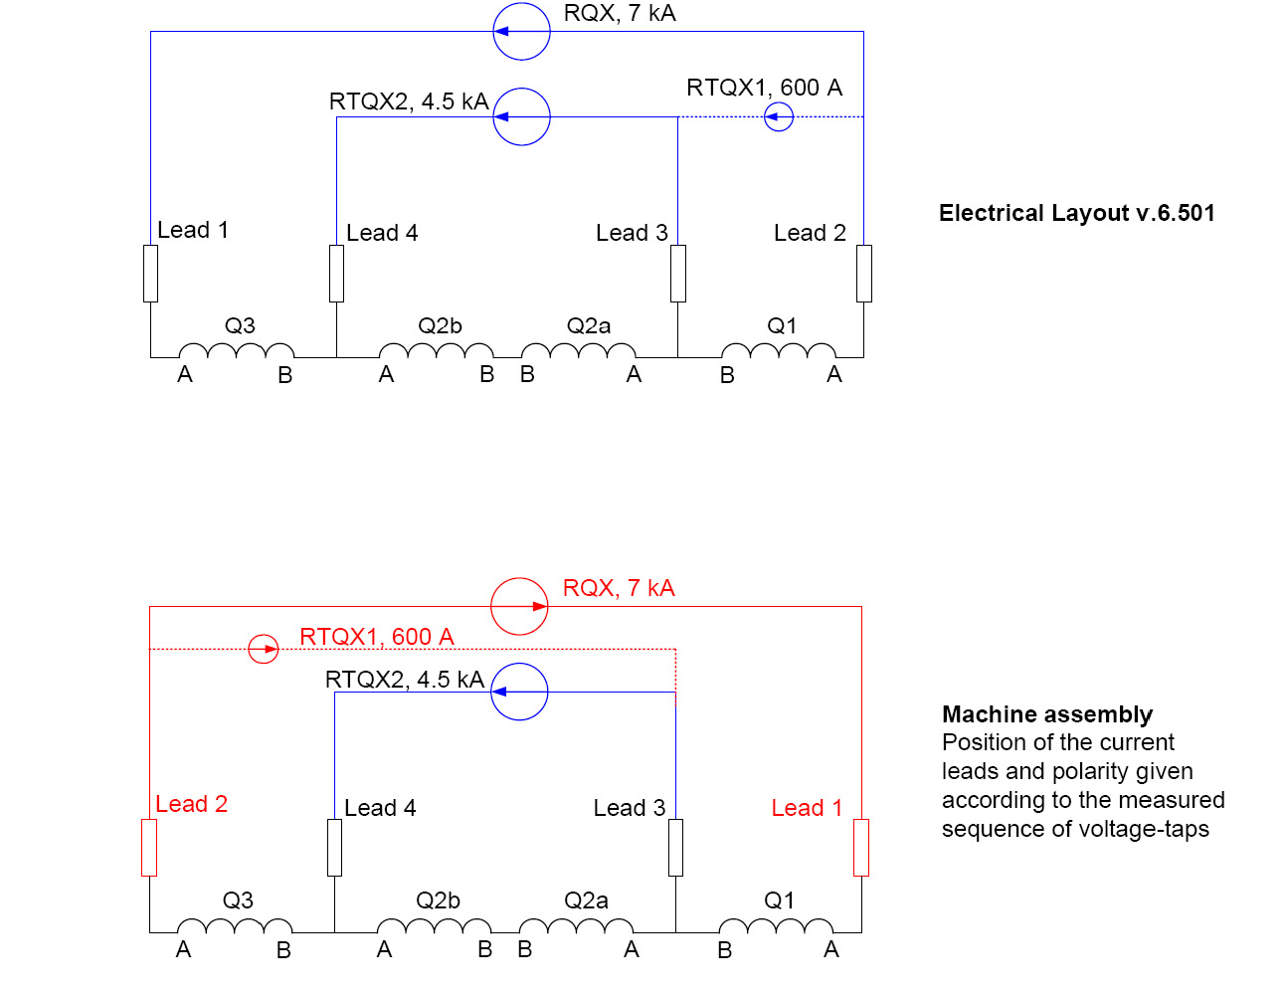
Non-conformities for sector 5-6 - IV
From NC report.

Slide 8
Non-conformities for sector 4-5 - I
Short statistics:
  35 NCs found
  34 NCs closed (but 19 With disposition “Decision pending”)
  1 NCs still opened
  32 ELQA-related NCs
  2 POW-related NCs
  1 NC: BPM at Q22.R4.B1

Slide 9
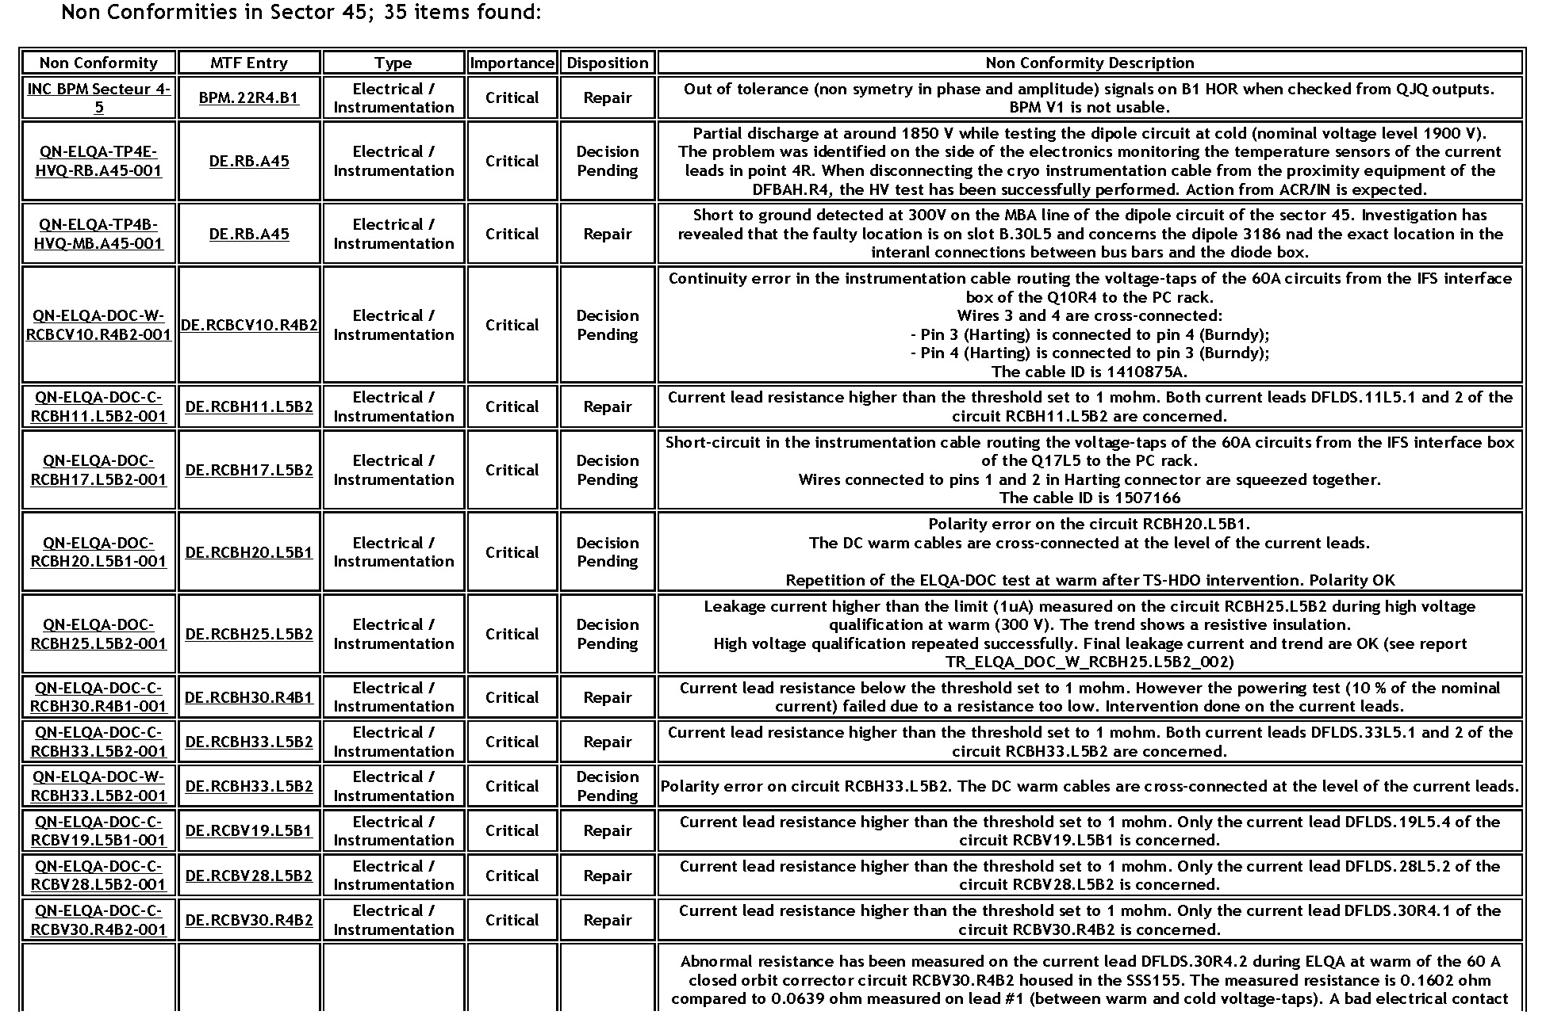
Non-conformities for sector 4-5 - II

Slide 10
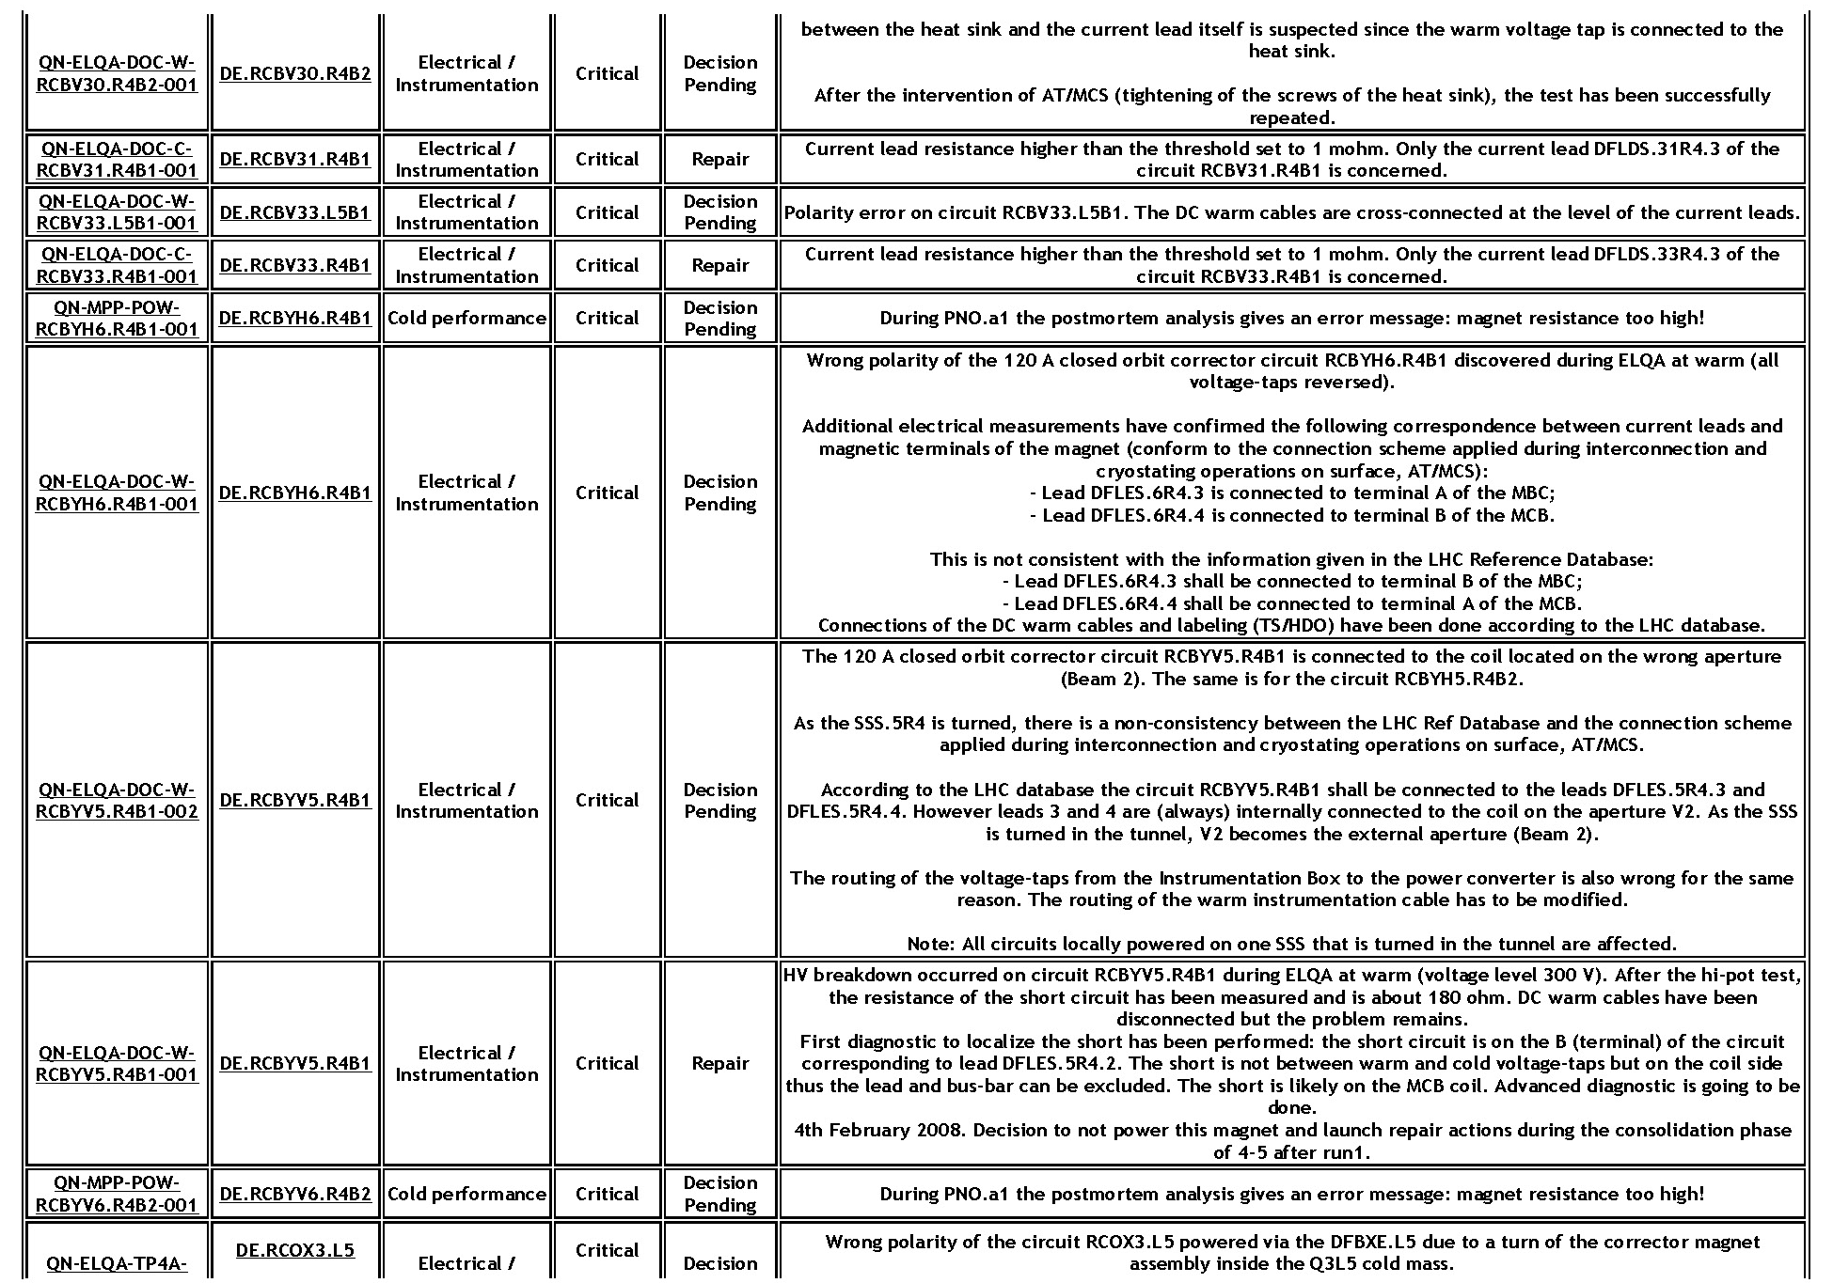
Non-conformities for sector 4-5 - III

Slide 11
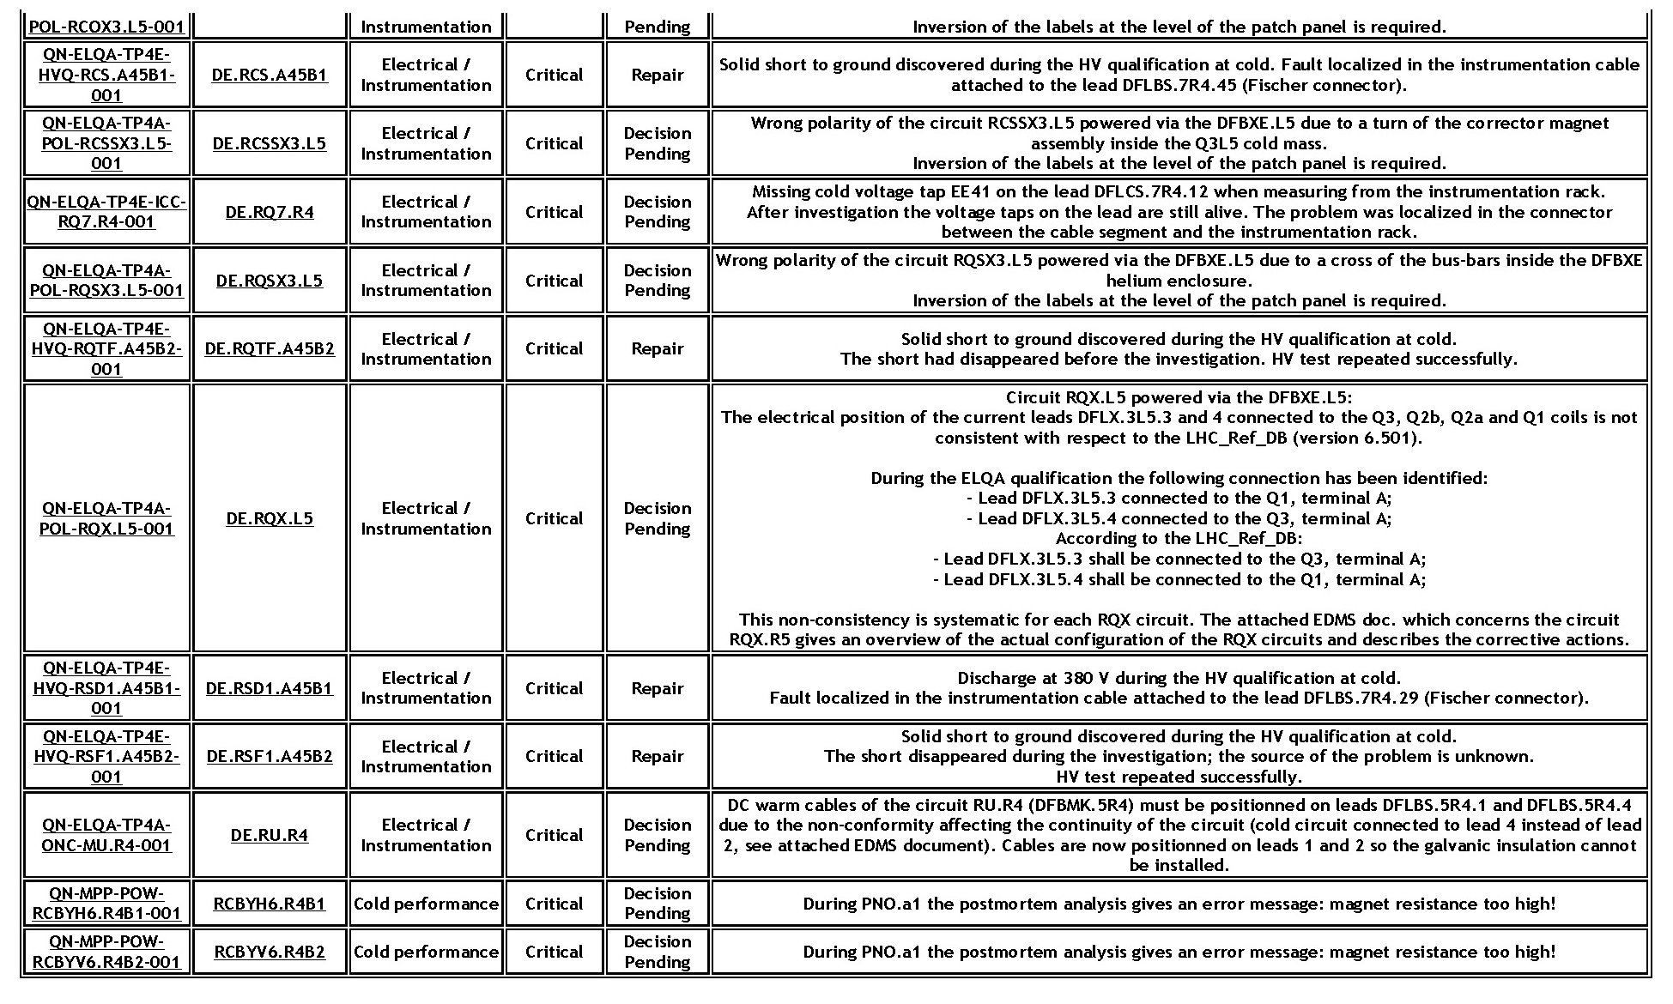
Non-conformities for sector 4-5 - IV

Slide 12
Non-conformities for sector 4-5 - V
Three main issues:
  BPM in Q22.R4.B1: repairing decided.
  Triplet quadrupoles (and correctors) polarity error: similar to sector 5-6.
  Closed orbit correctors:
    RCBYH6.R4B1 and RCBYV6.R4B2: reported problematic, but situation not clear. Feedback from Andrzej awaited.
    RCBYH5.R4B1: it was reported problematic at LTC (R. Wolf 30/01/08). Due to its importance, a repairing action was launched and completed. Special tests should be envisaged to assess the final status.

Slide 13
Follow up of powering strategies during hardware commissioning - I
Powering level for 80 A, 120 A, 600 A elements proposed and presented at the LTC (MG 23/04/08).
After-LTC refinements.
Documents for sectors 5-6 and 7-8 prepared (W. Venturini Delsolaro) and ready for formal approval.
Remaining issue: parameters used for the HC of the various circuits and their compatibility with operation. In particular: dI/dt, and d²I/dt².
Meeting with HC people organised (31/04/08).

Slide 14
CIRCUIT | ACC_PNO | ACC_PNO NOMINAL | DIDT_PNO | DIDT_PNO NOMINAL | I_PNO | I_PNO "NOMINAL" | Last passed
 | (A/s^2) | (A/s^2) | (A/s) | (A/s) | (A) | (A)
RQS.A56B2 | 0.1 | 0.1 | 5 | 5 | 550 | 550 | PNO.a3
RQT12.R5B1 | 0.1 | 0.1 | 5 | 5 | 400 | 400 | PNO.a3
RQT12.R5B2 | 0.1 | 5 | 5 | 5 | 550 | 550 | PNO.a3
RQT13.R5B1 | 0.1 | 0.1 | 5 | 5 | 400 | 400 | PNO.a3
RQT13.R5B2 | 0.1 | 0.1 | 5 | 5 | 400 | 400 | PNO.a3
RQT12.L6B1 | 0.1 | 0.1 | 5 | 5 | 400 | 400 | PNO.a3
RQT12.L6B2 | 0.1 | 0.1 | 5 | 5 | 400 | 400 | PNO.a3
RQT13.L6B1 | 0.1 | 0.1 | 5 | 5 | 400 | 400 | PNO.a3
RQT13.L6B2 | 0.1 | 0.1 | 5 | 5 | 400 | 400 | PNO.a3
RCD.A56B1 | 0.1 | 0.1 | 5 | 5 | 550 | 400 | PNO.a3
RCS.A56B1 | 0.1 | 0.1 | 5 | 5 | 400 | 400 | PNO.a3
RCS.A56B2 | 0.1 | 0.1 | 5 | 5 | 400 | 400 | PNO.a3
RQTD.A56B1 | 0.1 | 0.1 | 5 | 5 | 550 | 550 | PNO.a3
RQTD.A56B2 | 0.1 | 0.1 | 5 | 5 | 550 | 550 | PNO.a3
RSD2.A56B2 | 0.1 | 0.1 | 5 | 5 | 400 | 400 | PNO.a3
RCBXH1.R5 | 0.1 | 0.1 | 1.667 | 5 | 550 | 550 | 24 HOUR HEAT RUN
RCBXH2.R5 | 0.1 | 0.1 | 5 | 5 | 550 | 550 | 24 HOUR HEAT RUN
RCBXH3.R5 | 0.1 | 0.1 | 5 | 5 | 550 | 550 | 24 HOUR HEAT RUN
RCBXV1.R5 | 0.1 | 0.1 | 1.667 | 5 | 550 | 550 | 24 HOUR HEAT RUN
RCBXV2.R5 | 0.1 | 0.1 | 5 | 5 | 550 | 550 | 24 HOUR HEAT RUN
RCBXV3.R5 | 0.1 | 0.1 | 5 | 5 | 550 | 550 | 24 HOUR HEAT RUN
RQSX3.R5 | 0.1 | 0.1 | 5 | 5 | 550 | 550 | PCS
Courtesy W. Venturini Delsolaro

Slide 15
CIRCUIT | ACC_PNO | ACC_PNO NOMINAL | DIDT_PNO | DIDT_PNO NOMINAL | I_PNO | I_PNO "NOMINAL" | Last passed
 | (A/s^2) | (A/s^2) | (A/s) | (A/s) | (A) | (A)
RQTL11.R5B2 | 0.01 | 0.1 | 1 | 5 | 400 | 400 | PNO.d3
RSD1.A56B1 | 0.01 | 0.1 | 1 | 5 | 400 | 400 | PNO.a3
RSD2.A56B1 | 0.01 | 0.1 | 1 | 5 | 400 | 400 | PNO.a3
RSF1.A56B1 | 0.01 | 0.1 | 1 | 5 | 400 | 400 | PNO.a3
RQS.R5B1 | 0.03 | 0.1 | 3 | 5 | 550 | 550 | PNO.a3
RQTL11.L6B1 | 0.03 | 0.1 | 2 | 5 | 300 | 300 | PNO.a3
RQTL11.L6B2 | 0.03 | 0.1 | 3 | 5 | 400 | 400 | PNO.a3
RQTL11.R5B1 | 0.03 | 0.1 | 2 | 5 | 400 | 400 | PNO.a3
RCD.A56B2 | 0.03 | 0.1 | 3 | 5 | 400 | 550 | PNO.a3
RQS.L6B1 | 0.03 | 0.1 | 3 | 5 | 550 | 550 | PNO.a3
RQTF.A56B1 | 0.03 | 0.1 | 3 | 5 | 550 | 550 | PNO.a3
RQTF.A56B2 | 0.03 | 0.1 | 3 | 5 | 550 | 550 | PNO.a3
RSD1.A56B2 | 0.03 | 0.1 | 3 | 5 | 400 | 400 | PNO.a3
RSF1.A56B2 | 0.03 | 0.1 | 3 | 5 | 400 | 400 | PNO.a3
RSF2.A56B1 | 0.03 | 0.1 | 3 | 5 | 400 | 400 | PNO.a3
RSF2.A56B2 | 0.03 | 0.1 | 3 | 5 | 400 | 400 | PNO.a3
RCO.A56B1 | 0.1 | 0.1 | 1 | 5 | 80 | 45 | PCS
RCO.A56B2 | 0.1 | 0.1 | 1 | 5 | 80 | 45 | PNO.a3
ROD.A56B1 | 0.1 | 0.1 | 5 | 5 | 400 | 45 | PNO.a3
ROD.A56B2 | 0.1 | 0.1 | 5 | 5 | 400 | 45 | PNO.a3
ROF.A56B1 | 0.1 | 0.1 | 5 | 5 | 400 | 45 | PNO.a3
ROF.A56B2 | 0.1 | 0.1 | 5 | 5 | 400 | 45 | PNO.a3
RSS.A56B1 | 0.1 | 0.1 | 5 | 5 | 400 | 45 | PNO.a3
RSS.A56B2 | 0.1 | 0.1 | 5 | 5 | 400 | 45 | PNO.a3
Courtesy W. Venturini Delsolaro

Slide 16
Follow up of powering strategies during hardware commissioning - II
Next steps:
  Evaluate time-dependent parameters based on operational requirements. In particular, elements used for feedback should be considered in detail.
  Iterate with HC people (meeting in 10 days).

