Slide 1
Results from tests with B-field in LHCb

Slide 2
Why we had powered the magnet again:
Some final checks of
Safety System (MagnetControlSystem/MagnetSafetySystem)
Verification of isolation
Cutting water supply (TS/CV)
Beam Dump ( fast ramp down)
RICH 1 detector has shown a displacement of up to 1.7 mm after switching on the magnet to nominal current last October.
Verification of movements of Trigger Tracker and VELO.
Measurement of magnetic field and symmetry between positive and negative B-field.
Test of the RAMSES detector
Sub detector commissioning (RICH, BCM, …)
Nicolas Bourgoeis PH/DT
Gilles Le Godec AB/PO
Sandra Berni
Jean-Christophe Gayde

Slide 3
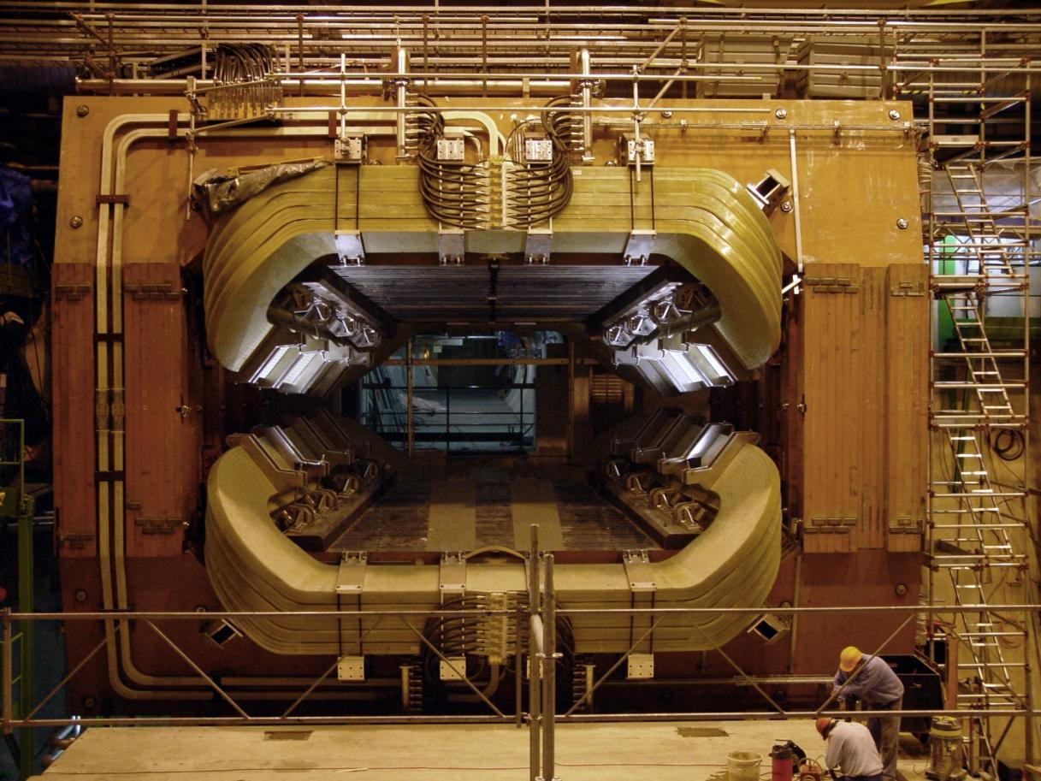
Four hall probes at two symmetric positions
3
0
1
2

Slide 4
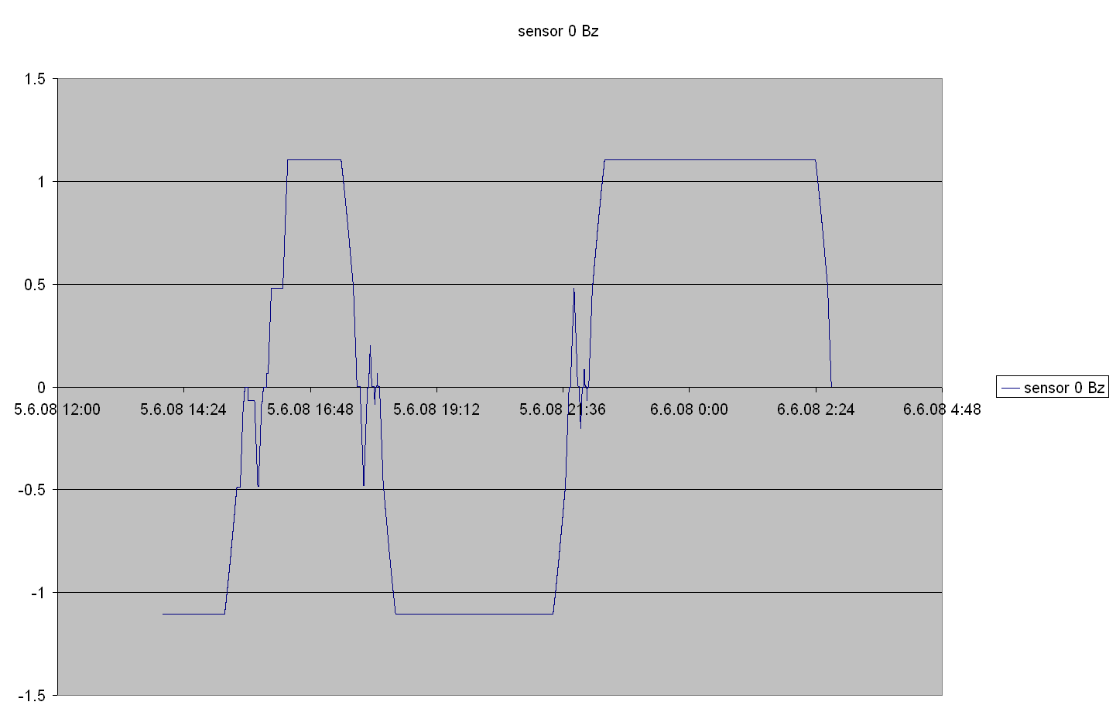
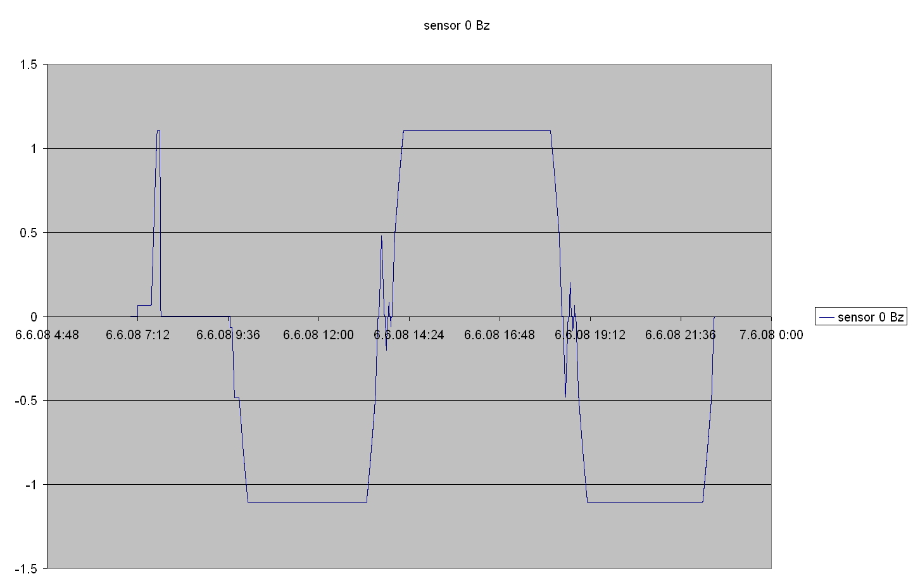
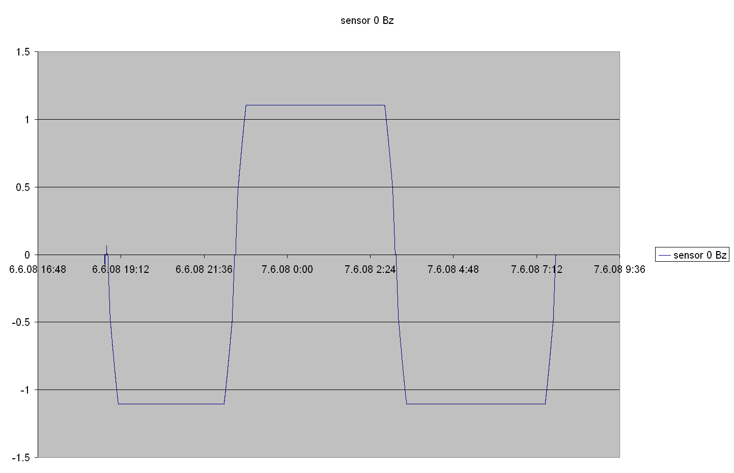
Data from three runs have been taken.

Slide 5
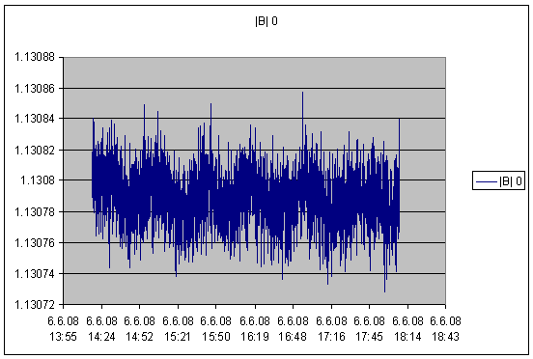
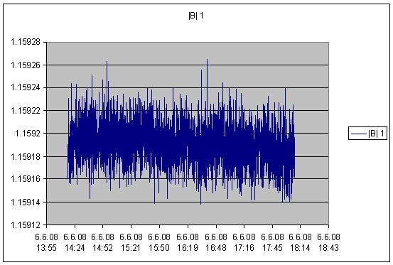
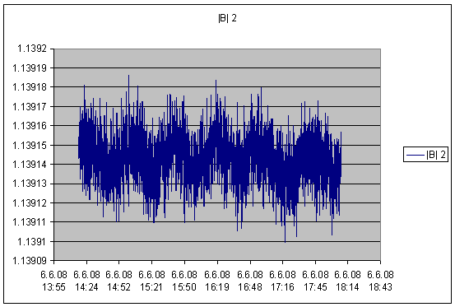
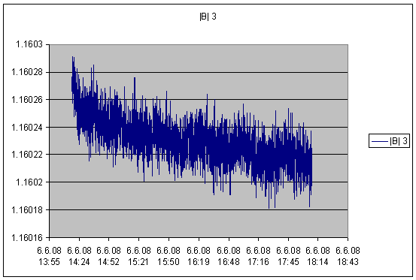
Variation of B-field at nominal value
for 4 sensors
~40min
?
~40min
~40min

Slide 6
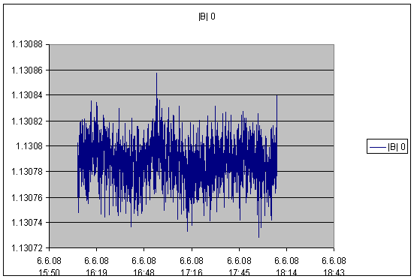
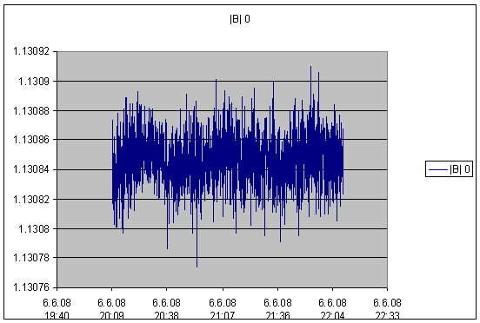
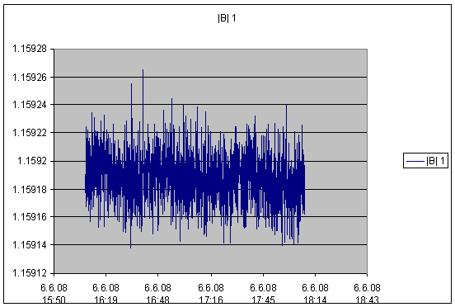
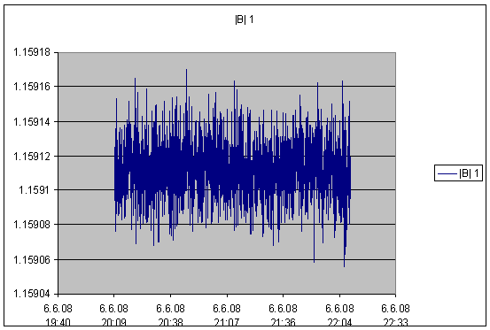
1.13079
1.13084
Comparison of B-field +/-
for two hall probes
1.15919
1.15911

Slide 7
Changing B-field without running through a sequence.

Slide 8
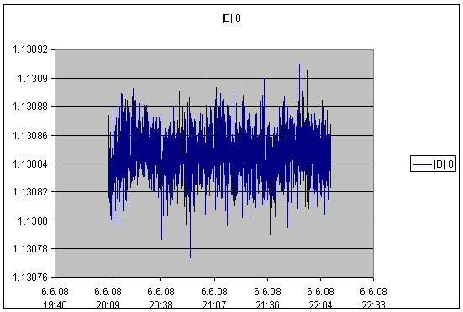
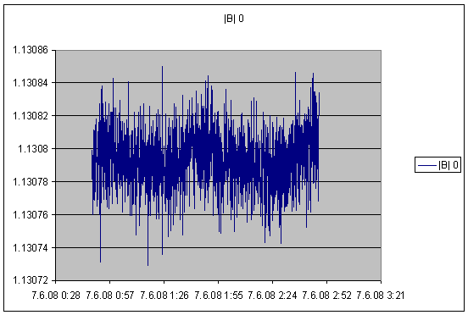
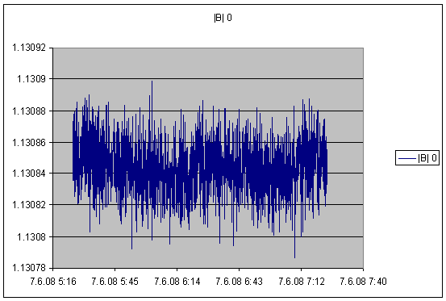
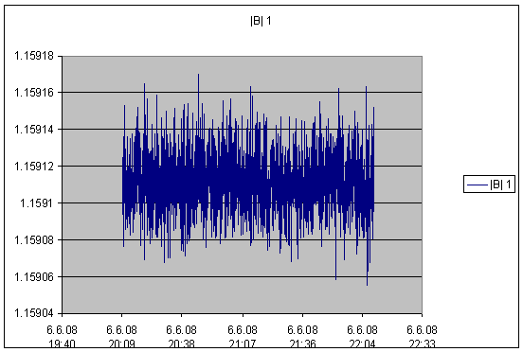
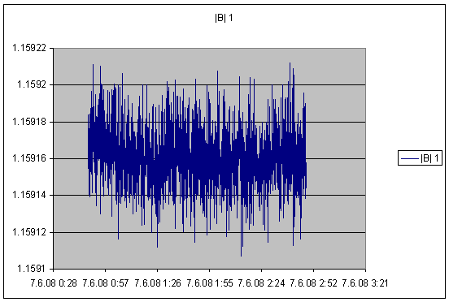
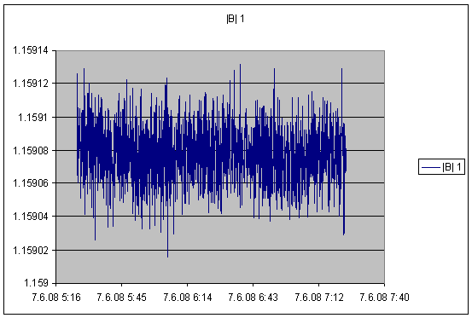
1.13084
1.13079
1.13085
Comparison of B-field +/-
for two hall probes, no ‘demagnetizing’
1.15911
1.15917
1.15908

Slide 9
The data taken has shown that the ‘demagnetizing’ cycle does not improves the symmetry of neg/pos B-field significantly.
The measured values (B⁻ - B⁺) <0.0001 T at ~1.13 T seem to be sufficiently good.

Slide 10
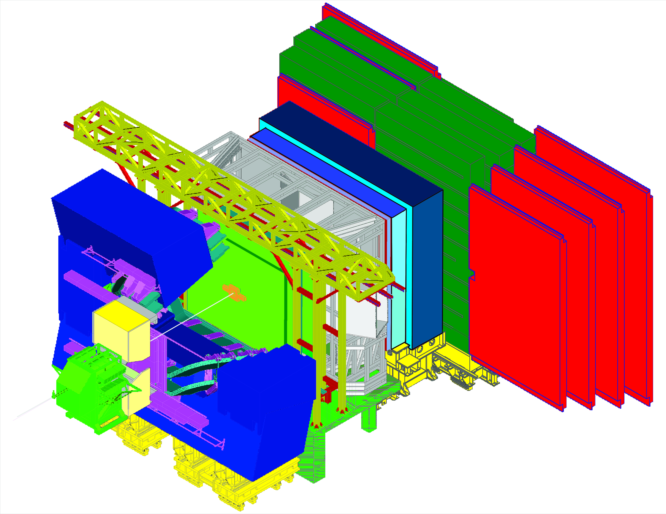
Magnetic field for detector commissioning
Measurements with RICH 2
RICH 2
Slides from Carmelo D’Ambrosio

Slide 11
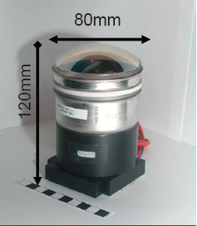
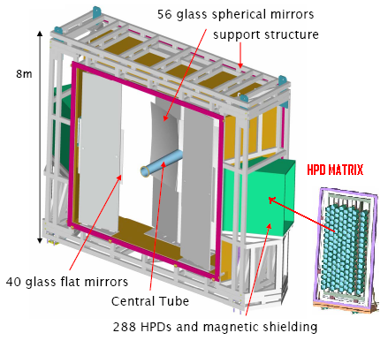
Why do we need magnetic meas. for RICH2?
Cherenkov light is detected by Hybrid Photon Detector (HPD)
HPDs operate in the fringe field of LHCb dipole magnet

Slide 12
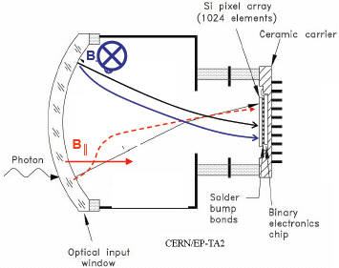
Due to the magnetic field, electrons trajectories deviate from the designed electrostatic trajectories
Distortions on the photocathode image will increase the Cherenkov angle error
Measurement with and without magnetic field will give us the possibility to characterize, quantify and correct the distortion effect

Slide 13
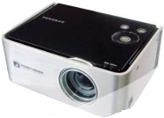
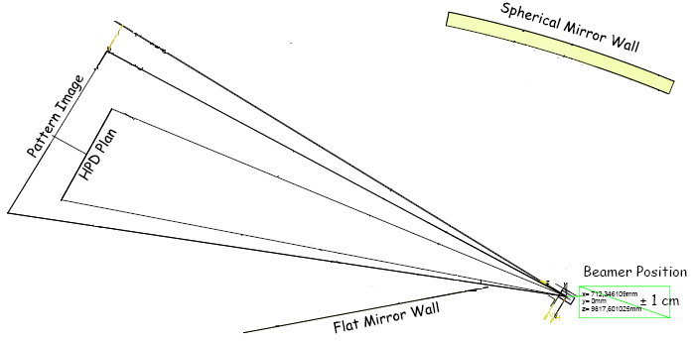
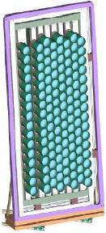
Experimental Setup for RICH2
Shine a well defined pattern onto the HPD plan (both for A and C side) using a commercial beamer
Green light spots
© Carmelo + RICH group

Slide 14
During magnet test week we took data with magnet ON (both plus and minus polarity @ full and half field)
So now we can compare points position with and without magnetic field
Single HPD with magnet ON+, OFF, ON-
© Carmelo + RICH group

Slide 15
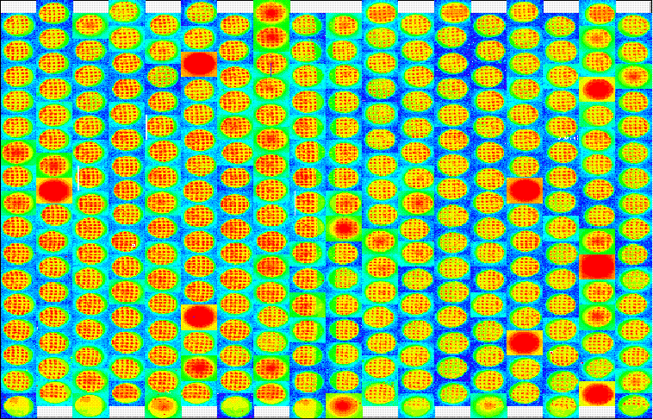
Data with magnet ON…
HPD matrix with pattern with magnet ON+, OFF, ON-
© Carmelo + RICH group

Slide 16
Final checks of the MagnetControlSystem/MagnetSafetySystem have been performed.
Improvement of detector fixation have been verified.
Sub detectors commissioned their equipment with B-field.
Stability and B-Field asymmetry have been measured.
The period with magnetic field in LHCb was very successful:
We would like to thank the AB/OP group for their great support and we are grateful to Reyes for her commitment and assistance!!!

