Slide 1
Integration Tests continued
Mike Lamont

Slide 2
Integration tests
Ongoing dry runs
Beam Dump, Injection, PGC
Software tests/dry runs
From CCC using controls infrastructure and software - check functionality of the individual systems – continous mode
RF, Collimators, Beam Instrumentation
Experiments
Communication, magnets…
Machine protection tests
PGC+, PGC++
Machine Protection commissioning
Partial machine checkout
Full machine checkout

Slide 3
PGC+: Generation
Sort optics etc. out to the full
details, details (acc, dec, corrections…)
Injection actual settings
Collimators
Kickers
Context independent
Power converter parameters
Pre-cycle, injection, ramp, squeeze, collide, ramp-down
Ramp variations – energy/optics
Squeeze variations
All knobs, bumps
separation bump
crossing angle bump
Q, Q’

Slide 4
PGC+: FIDEL
Deploy and check everything we’ve got from Luca & team
Transfer functions for all magnet circuits
Harmonic errors for quads and bends
Decay correction at injection
all multipoles
Snapback correction at start of ramp

Slide 5
PGC+: Drive
Full cycle tests of all available circuits
plus RF (test devices), and collimators
Check and set full parameter space
Pre-cycle, injection, ramp, squeeze, collide, ramp-down
Establish near-perfect control of power converters
Circuit limits, parameters…
Test trim (acc, dec, dI/dt…)
Tune [lattice, correction]
Chromaticity
Multipoles
Separation bumps
Coupling

Slide 6
Physics/Experiments Dry Run
Luminosity
Acquisition and display, BRA application
Optimization, trims, bumps etc.
Dry Luminosity Scans
Experiment Instrumentation & signals
BCMs, Lumi etc.
Experiment communication
DIP – to & from
Vetos, Handshakes
Interlocks
Beam abort, injection inhibit
Magnets
Alice/LHC dipoles and compensation

Slide 7
Hardware tests/dry runs
 | Tests
INJECTION KICKERS | Dry run
BEAM DUMP | Dry run
POWER CONVERTERS | PGC[++]
COLLIMATORS | Include in PGC when available
RF | LSA roll out and tests June System available end June for dry runs
TRANVERSE FB | Whenever
MAGNETS | PGC
MKQA , AC dipole etc. | IST
WARM MAGNETS | PGC TI8/2 DR
SPECTROMETERS etc. | Tests in June – LHCb and Alice
MACHINE PROTECTION | Rattle

Slide 8
RF - LSA
Value generator 1
Value generator 2
Makerule 7
MOMENTUM
BUCKET_AREA
Cavity_Q
SYNCH_FREQUENCY
Makerule 12
BUCKET_AREA_CALC
COUPLER_POS
Makerule 5
Makerule 1
Value generator 3
RF_TOTAL_VOLTAGE
RFVOLTAGE_PARTITION
Makerule 6
DELTAP_P
Makerule 2
Value generator 4
RFVOLTAGE_AMPL
RFVOLTAGE_PHASE
Makerule 4
Makerule 3
RFVOLTAGE_Q
RFVOLTAGE_I
CAVITY CONTROLLER

Slide 9
Objectives – Hardware - generics
 | Application | XPOC | Analog Acquisition | Alarms | SIS | MCS | PM | Timing | RBAC
INJECTION KICKERS | X |  | X | X |  | X | X | X | X
BEAM DUMP | X | X | X | X |  | X | X | X | X
POWER CONVERTERS | XX |  |  | X | X |  | X | X | X
COLLIMATORS | X |  |  | X | X | X | X | X | X
RF | XX |  | X | X | X |  | X | X | X
TRANVERSE FB | X |  | X | X |  |  | X | X | X
MAGNETS | XX |  |  | X |  |  | X
MKQA etc | X |  |  | X | X |  | X | X | X
WARM MAGNETS | X |  |  | X | X |  | X | X | X
RADIATION MONITORS |  |  |  | X |  |  | X
SPECTROMETERS |  |  |  | X | X |  | X | X

Slide 10
Software tests
http://lhc-commissioning.web.cern.ch/lhc-commissioning/dry-runs/systems/software-tests.htm
Plus a test environment

Slide 11
PGC++ - sectors 78 and 81
Extended test of two cold sectors
Machine Protection
BIS to BLM, BIS to PIC, BIS to LHCb, BIS to injection
LHCb
Dipole and compensators, Communication with Experiment
Nominal Cycle
2 sectors: pre-cycle, injection, ramp, squeeze plus septa/end TI8
Injection
TDI, Kickers, BI, End TI8
Beam Instrumentation
BPM, BLM,
Natural lead in to an injection test

Slide 12
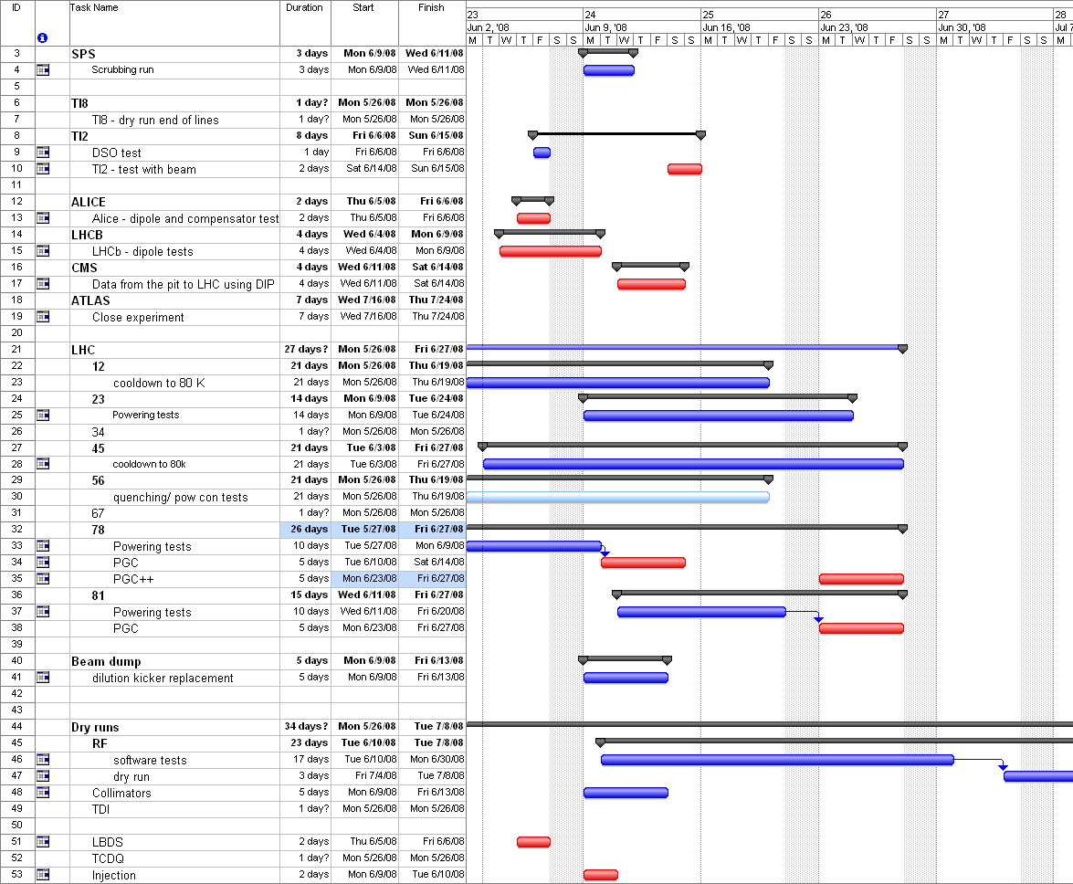
Schedule

