Slide 1
5 TeV Settings
Mike Lamont

Slide 2
Currents required for 5 TeV
Pull out maximum strength for all circuits
include squeeze to 55 cm in IR 1 & 5
squeeze to 2 m in IR 8
Calculate current at 5 & 7 TeV using
Default transfer functions from layout database
FIDEL where available
Group circuits by circuit type and assigned required maximum current
Give to HWC

Slide 3
Currents/Circuit
CIRCUIT | CALIB/MAGNET TYPE | 5 TeV Max Current | 7 TeV Max Current
RB.A12 | MB_FIDEL | 8423 | 11852
RB.A23 | MB_FIDEL | 8423 | 11852
RB.A34 | MB_FIDEL | 8423 | 11852
RB.A45 | MB_FIDEL | 8423 | 11852
RB.A56 | MB_FIDEL | 8423 | 11852
RB.A67 | MB_FIDEL | 8423 | 11852
RB.A78 | MB_FIDEL | 8423 | 11852
RB.A81 | MB_FIDEL | 8423 | 11852
RD1.LR1 | MBRB | 1454 | 2036
RD1.LR5 | MBRB | 1454 | 2036
RD4.L4 | MBRB | 4376 | 6126
RD4.R4 | MBRB | 4376 | 6126
RD2.L1 | MBRC | 3146 | 4404
RD2.L2 | MBRC | 4272 | 5981
RD2.L5 | MBRC | 3146 | 4404
RD2.L8 | MBRC | 4272 | 5981
RD2.R1 | MBRC | 3146 | 4404
RD2.R2 | MBRC | 4272 | 5981
RD2.R5 | MBRC | 3146 | 4404
RD2.R8 | MBRC | 4272 | 5981
RD3.L4 | MBRS | 4376 | 6126
RD3.R4 | MBRS | 4376 | 6126
RD34.LR3 | MBW | 470 | 658
RD34.LR7 | MBW | -470 | -658
RD1.L2 | MBX | 4129 | 5781
RD1.L8 | MBX | 4129 | 5781
RD1.R2 | MBX | 4129 | 5781
RD1.R8 | MBX | 4129 | 5781

Slide 4
Etc…
CIRCUIT | CALIB/MAGNET TYPE | 5 TeV Max Current | 7 TeV Max Current
RQ10.L1B1 | MQM | 3302 | 4623
RQ10.L1B2 | MQM | 3434 | 4808
RQ10.L2B1 | MQM | 3094 | 4332
RQ10.L2B2 | MQM | 3378 | 4729
RQ10.L4B1 | MQM | 2944 | 4121
RQ10.L4B2 | MQM | 3231 | 4524
RQ10.L5B1 | MQM | 3302 | 4623
RQ10.L5B2 | MQM | 3434 | 4808
RQ10.L6B1 | MQM | 2768 | 3876
RQ10.L6B2 | MQM | 3166 | 4432
RQ10.L8B1 | MQM | 2930 | 4102
RQ10.L8B2 | MQM | 3232 | 4525
RQ10.R1B1 | MQM | 3343 | 4680
RQ10.R1B2 | MQM | 3343 | 4680
RQ10.R2B1 | MQM | 3384 | 4737
RQ10.R2B2 | MQM | 3755 | 5257
RQ10.R4B1 | MQM | 3210 | 4495
RQ10.R4B2 | MQM | 3029 | 4240
RQ10.R5B1 | MQM | 3343 | 4680
RQ10.R5B2 | MQM | 3343 | 4680
RQ10.R6B1 | MQM | 3204 | 4486
RQ10.R6B2 | MQM | 2825 | 3955
RQ10.R8B1 | MQM | 3383 | 4736
RQ10.R8B2 | MQM | 2920 | 4088

Slide 5
Group
Circuit Type | Magnet Type | Max required current at 5 TeV | Max required current at 7 TeV | Comment
RB | MB | 8500 | 11860
RD1.LR | MBRB | 1500 | 2100
RD4 | MBRB | 4400 | 6200
RD2 | MBRC | 4300 | 6000
RD3 | MBRS | 4400 | 6200
RD34 | MBW | 470 | 660
RD1 | MBX | 4200 | 5800
RQD | MQ | 7700 | 10700
RQF | MQ | 8000 | 11200
RQ10 | MQM | 3500 | 4800
RQ6 | MQM | 3100 | 4400
RQ7 | MQM | 3900 | 5400
RQ8 | MQM | 3600 | 5000
RQ9 | MQM | 3500 | 4900
RQ5 | MQML | 2799 | 3800

Slide 6
Group
Circuit Type | Magnet Type | 5 TeV | 7 TeV | Comment
RQT12 | MQT | +/-390 | +/-540 | Large variations - could narrow range per sector
RQT13 | MQT | +/-390 | +/-540 | Large variations
RQT4/5 | MQT | 80 | 110
RQ6.R7 | MQTLH | 260 | 360
RQTL10 | MQTLI | 310 | 430
RQTL11 | MQTLI | 380 | 530 | Large variations
RQTL7 | MQTLI | 360 | 510
RQTL8 | MQTLI | 240 | 340
RQTL9 | MQTLI | 280 | 380
MQXA | MQXA | 5000 | 7000
MQXB | MQXB | 8300 | 11600
RQ4 | MQY | 2100 | 2900
RQ4.LR | MQY | 500 | 700
RQ5 | MQY | 2600 | 3600
RQ5.LR | MQY | 510 | 710
RSD | MS | 250 | 350 | Plus some room for trims
RSF | MS | 200 | 250 | Plus some room for trims

Slide 7
Circuits for which MAD does not supply strengths - either set empirically or using FIDEL
Circuit Type | Magnet Type | 5 TeV | 7 TeV | Comment
RCO | MCO | 550 | 550 | oct spool – Landeau damping (lower priority
RCD | MCD | 0 | 0 | Dec spool - leave
ROD | MO | 0 | 0 | Lat oct - leave
ROF | MO | 0 | 0 | Lat oct - leave
RQTD | MQT | 550 | 550 | tune trim
RQTF | MQT | 550 | 550 | tune trim
RCS | MCS | 550 | 550 | sex spool - use
RSS | MSS | 0 | 0 | skew sex - leave
RQS | QS | 550 | 550 | skew quads - trim
RCTX | MCTX | 0 | 0 | IT correction - leave
RCSX | MCSX | 0 | 0 | IT correction - leave
RCSSX | MCSSX | 0 | 0 | IT correction - leave
RCOX | MCOX | 0 | 0 | IT correction - leave
RCOSX | MCOSX | 0 | 0 | IT correction - leave

Slide 8
All orbit correctors to nominal
MCBH | 55
MCBV | 55
MCBCH | 100
MCBCV | 100
MCBYH | 72
MCBYV | 72
MCBXH | 550
MCBXV | 550
etc.

Slide 9
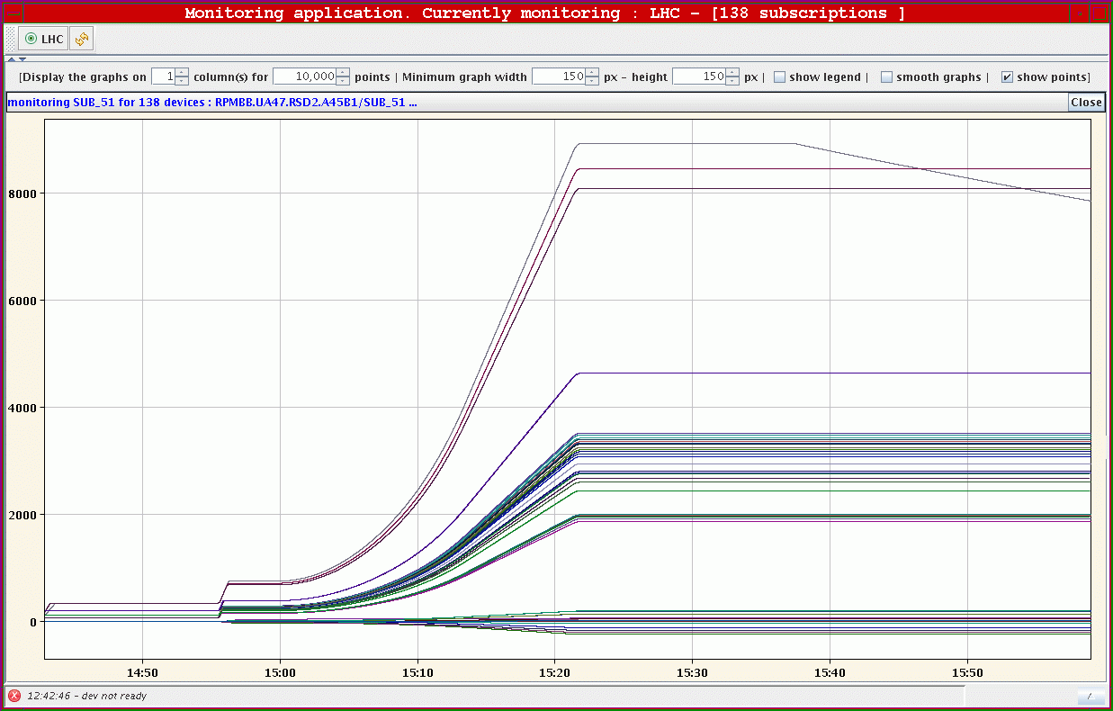
And test…

Slide 10
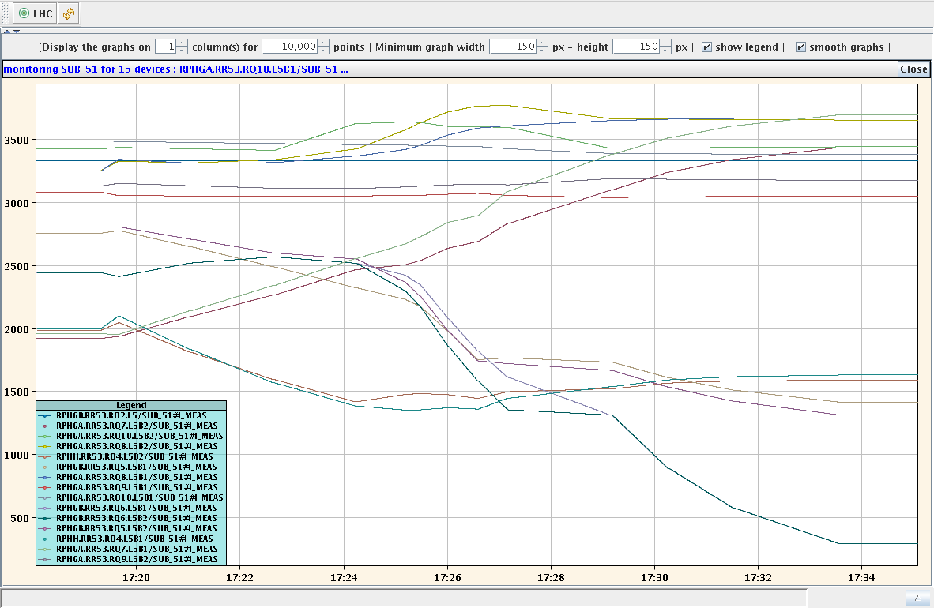
And test…

